Slide 1
CBDCs and their impact on religious liberty

Slide 2
Disclaimer
This talk is for educational purposes only. This is NOT financial, investment, or legal advice.
You are solely responsible for your own financial decisions.
This is not a recommendation to buy or sell any particular financial instrument or commodity. There is a substantial risk of loss associated with trading currencies, securities, options on equities and options on futures. Futures, options, commodity and currency trading all have large potential rewards, but they also have large potential risk and may result in monetary losses. You must be aware of the risks and be willing to accept them in order to invest or trade in the financial markets. Trading securities is not suitable for everyone. Do not trade with money that you cannot afford to lose.
You should consult your Registered Financial Advisor and your Risk Trading Plan before ever investing or trading any financial instrument or commodity.
CFTC (Commodity Futures Trading Commission) RULE 4.41 – HYPOTHETICAL OR SIMULATED PERFORMANCE RESULTS HAVE CERTAIN LIMITATIONS. UNLIKE AN ACTUAL PERFORMANCE RECORD, SIMULATED RESULTS DO NOT REPRESENT ACTUAL TRADING. ALSO, SINCE THE TRADES HAVE NOT BEEN EXECUTED, THE RESULTS MAY HAVE UNDER-OR-OVER COMPENSATED FOR THE IMPACT, IF ANY, OF CERTAIN MARKET FACTORS, SUCH AS LACK OF LIQUIDITY. SIMULATED TRADING PROGRAMS IN GENERAL ARE ALSO SUBJECT TO THE FACT THAT THEY ARE DESIGNED WITH THE BENEFIT OF HINDSIGHT. NO REPRESENTATION IS BEING MADE THAT ANY ACCOUNT WILL OR IS LIKELY TO ACHIEVE PROFIT OR LOSSES SIMILAR TO THOSE SHOWN.

Slide 3
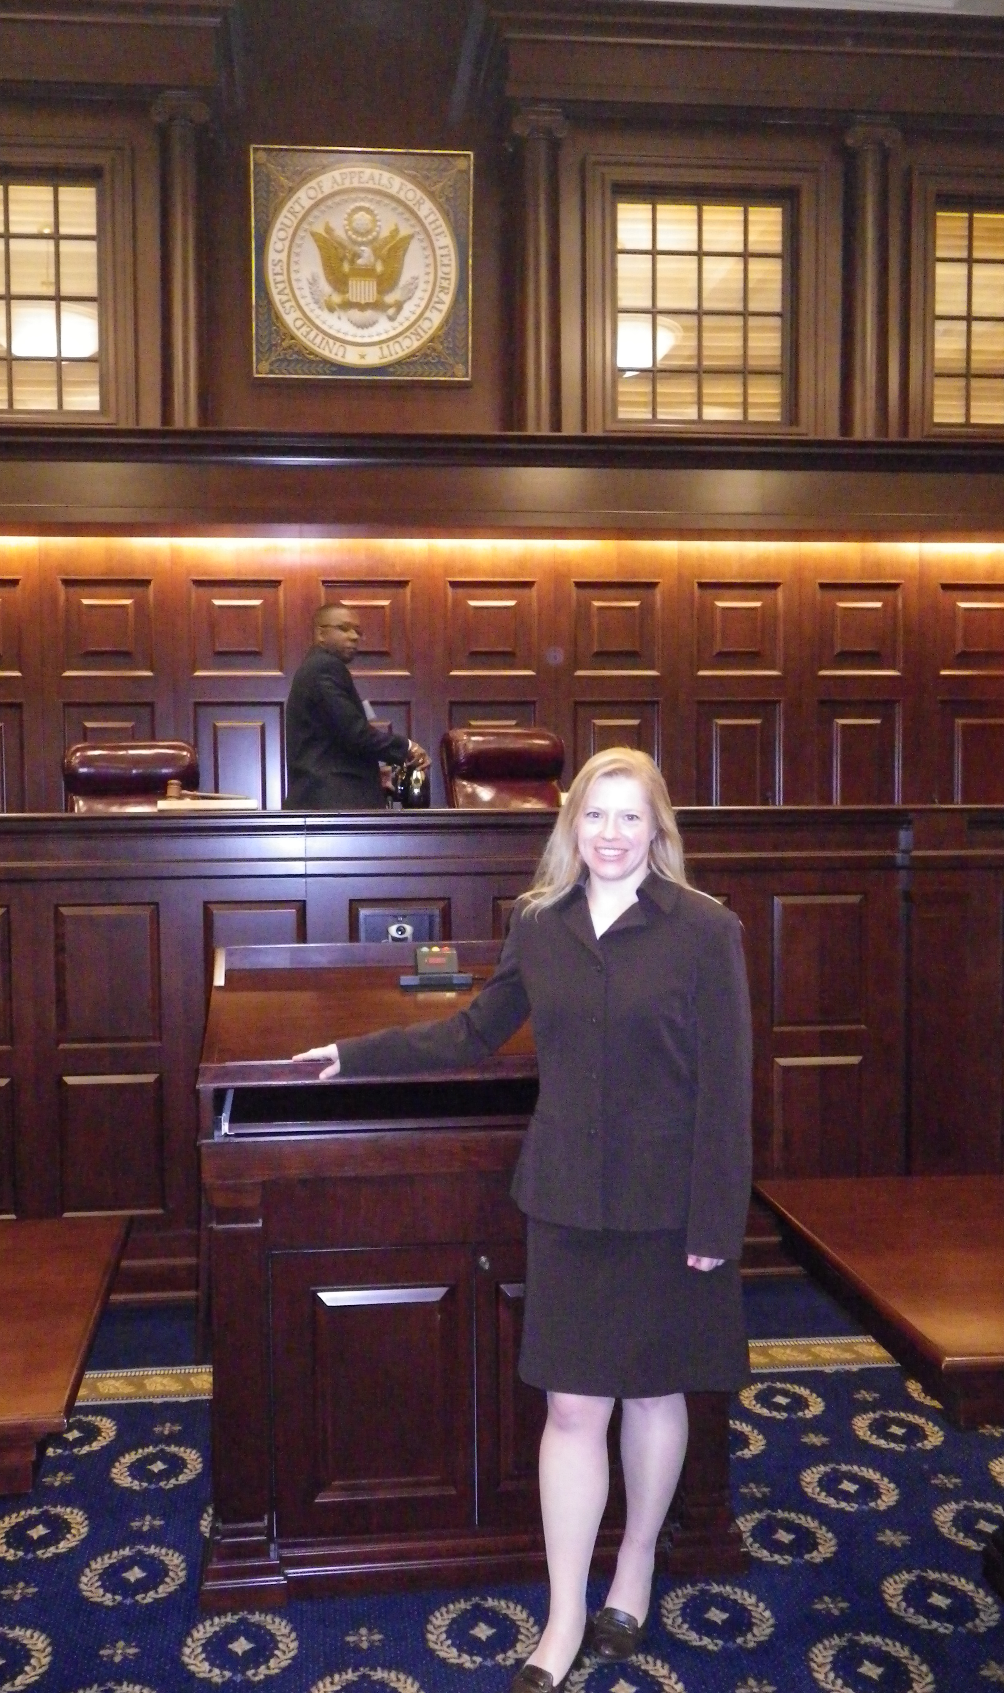
Who am I?
New York Attorney and
Trader of Currencies and Equity and Commodity Futures
I am a licensed attorney in the State of New York. I graduated from Dickinson School of Law (Penn State Dickinson) and was admitted to the New York Bar in 1998. I practiced law for 19 years before retiring from the active practice of law to trade currencies, and equity and commodity futures in the financial markets.
As such, I constantly monitor the activity and monetary policies of the Central Banks around the world.
It is my job to know what is happening with money.

Slide 4
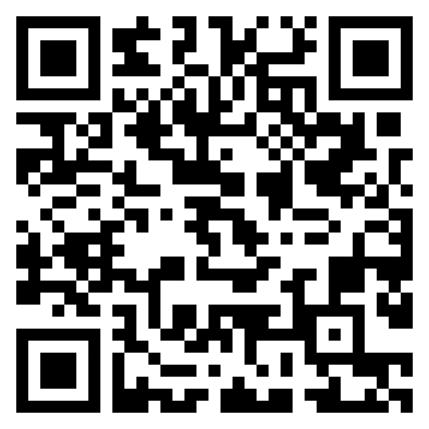
My ministry: https://revelation1317cbdcwatch.substack.com/
“And that no man might buy or sell, save he that had the mark, or the name of the beast, or the number of his name.”
Revelation 13:17
Notes:
Well how could this happen? How could someone control what it is that you buy or sell? How could someone prevent you from buying whatever it is that you want to buy? CBDCs and tokenization of all assets on a Global Unified Ledger is how. These are 2 constructs being developed and instituted NOW that will directly impact our religious liberty.
Revelation 13:17 CBDC Watch
The objective of Revelation1317CBDCwatch.substack.com is to examine of current events and news involving currencies, finance, central banks, and their monetary policies, with an eye toward Biblical end-times prophesies, particularly those in the book of Revelation.
I share my thoughts and analysis about central bank developments worldwide, with an eye toward Biblical end-times prophesies. I am inspired to do it because the monetary and technological developments and potential actions being explored, discussed, and piloted by the central banks around the world will change our monetary system, while surveilling and enslaving individuals around the world in a way that is strikingly consistent with these end-times prophesies. I feel compelled to sound the alarm.

Slide 5
What are CBDCs?
Central Bank Digital Currency (CBDC) is fully programmable, fully traceable digital currency that is centralized and distributed by a government or its central bank. Because it is centralized to one authority, as opposed to being decentralized, it is fully controlled and programmed by the authority that issues it. This means the government can (1) surveil all financial transactions and (2) control when, where, and upon what you can spend the currency.

Slide 6
What are CBDCs?
With CBDCs, the government would have the authority to decide, and the power to enforce, how you may or may not spend the CBDC that is assigned to your digital wallet which would be tied to your digital ID. CBDCs are designed to financially constrain the user in any way that the government wishes to constrain the user, to elicit whatever behavior it wants from the user.

Slide 7
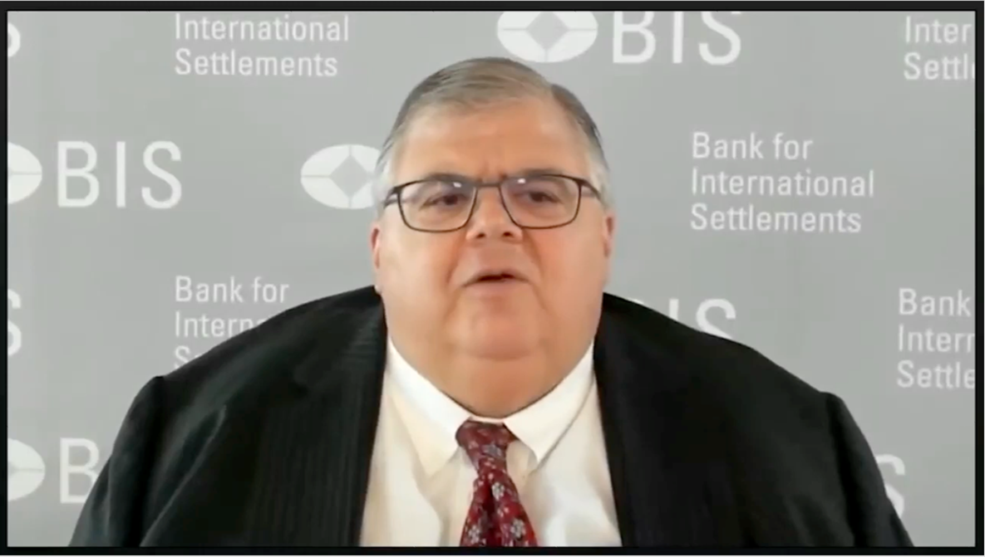
BIS General manager, Oct 2020 describing the difference between cash and digital currency:
“The Central Bank will have ABSOLUTE CONTROL on the rules and regulations that will determine the use of that expression of central bank liability and will have the technology to ENFORCE that.” – Bank of International Settlements (BIS) General Manager, Agustin Carstens
Notes:
https://youtu.be/rpNnTuK5JJU?si=RX9jRV1Wzfi_7Cyv

Slide 8
“Government digital cash is a formula for tyranny.” – Steve Forbes, Forbes Magazine https://youtu.be/SdIb9_I-kkA?si=39vulEbdCuCE-qFe
CBDCs are an attack on our freedom and will be the end of financial freedom.
Notes:
https://youtu.be/SdIb9_I-kkA?si=39vulEbdCuCE-qFe

Slide 9
What is true freedom?
True freedom is financial freedom, which is the freedom to conduct whatever financial transactions you choose to conduct; to spend your money as you please; to give to the charities of your choice; or to save as much of your money as you deem appropriate.

Slide 10
Cash vs. CBDCs
CBDCs
No privacy in any financial transaction. No anonymity.
CBDCs would be fully traceable, meaning that every transaction would be recorded and monitored by the central bank. This would allow central banks to surveil and control financial transactions in ways that were previously impossible. This will be government SURVEILLANCE of all Americans’ financial transactions. This is the antithesis of freedom and is contrary to the 4th Amendment of our US Constitution.
CBDCs are digital, not physical, meaning that you will not be able to access your money when the power is out or when the network is down.
The currency is programmable, meaning that the government and/or central bank will set the rules as to how, when, where, and on what items that currency can be spent.
If the Federal Government wanted to outlaw or further restrict the sale or purchase of guns, a further attack on our 2nd Amendment rights, it could program the CBDC such that it could not be used to purchase guns.
We live in a consumption-based economy. If the government decides that the country’s consumer spending numbers are too weak, ie, consumers are not spending enough or are saving too much of their money, the Federal Reserve could program the CBDC to expire within 30 days, forcing you to spend the digital cash and convert it to goods before the CBDC evaporates.
Cash
Cash transactions offer the secrecy and anonymity that is necessary to have financial freedom.
People can use cash to make transactions without leaving a paper trail, which is a fundamental right in a democratic society.
Cash does not expire.
Cash is not dependent upon electricity or network coverage. You can use cash when the power is out or in the event of a network outage.
Cash is physical. You can hold it in your hand.
When you hold cash, you own cash.

Slide 11
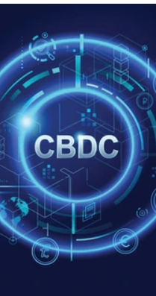
With a CBDC a Central Bank or Government can…
See all of your transactions in real time and tax you accordingly.
Mandate that any and all booster shots must be taken. They will have the ability to turn off our money or freeze our balances if we do not comply.
Turn off our money if they do not like our political views or what we post on social media.
Turn off our money if they do not like our religious beliefs or practices. If the government passed a Sunday law mandating that all people worship on Sunday, the government could turn off your money or otherwise restrict your spending of the CBDC in your assigned digital wallet if you do not comply.
The CBDC could be programmed to expire within 30 days, forcing us to spend our money and convert it to goods before it evaporates.
Your money could be programmed so that it cannot be used to buy certain foods, goods or services (flights, rental cars, etc) if they deem your carbon footprint or carbon score is too high.
The Fed could institute negative interest rates, which would cause a portion of your money to be periodically DEDUCTED from your account/digital wallet. (Japan instituted negative interest rates in 2016 and still maintained negative interest rate policy through 2023).

Slide 12
CBDCs are being explored, tested and developed worldwide…
According to data from the Atlantic Council, 114 countries are exploring or developing a CBDC –See https://www.atlanticcouncil.org/cbdctracker/
Currently 60 countries are in the advanced phases of exploration of a CBDC
To date, these 10 countries have launched their own retail CBDC:
Nigeria (e-Naira)
Bahamas (Sand Dollar)
Antigua and Barbuda (DCash)
Dominica (DCash)
Grenada (DCash)
As of December 2022, all G7 economies had entered the development stage of a CBDC.
China’s pilot was expanded to reach most of the country in 2023.
A 2022 survey conducted by the Bank of International Settlements (BIS) revealed that 93% of the 86 Central Banks it surveyed have or are Developing a CBDC. It was projected that there could be 15 retail CBDCs publicly circulating by 2030. https://www.bis.org/publ/bppdf/bispap136.pdf
St. Lucia (DCash)
Montserrat (DCash)
St. Vincent and the Grenadines (DCash)
St. Kitts and Nevis (DCash)
Jamaica (Jam-Dex)
Notes:
The Eastern Caribbean Currency Union: Antigua and Barbuda, Dominica, Grenada, Montserrat, St. Kitts and Nevis, Saint Lucia, and St. Vincent and the Grenadines.
Anguilla was the only country in the union that opted out.
https://www.bis.org/publ/bppdf/bispap136.pdf

Slide 13
https://cbdctracker.org/
Notes:
https://cbdctracker.org/

Slide 14
CBDCs In the Pilot Program Stage As of December 2023 (Retail only)

Slide 15
US: Biden’s Executive Order No. 14067
On March 9, 2022, President Biden issued Executive Order No. 14067 on Ensuring Responsible Development of Digital Assets, outlining plans to convert the U.S. monetary system to central bank digital currencies (CBDCs).

Slide 16
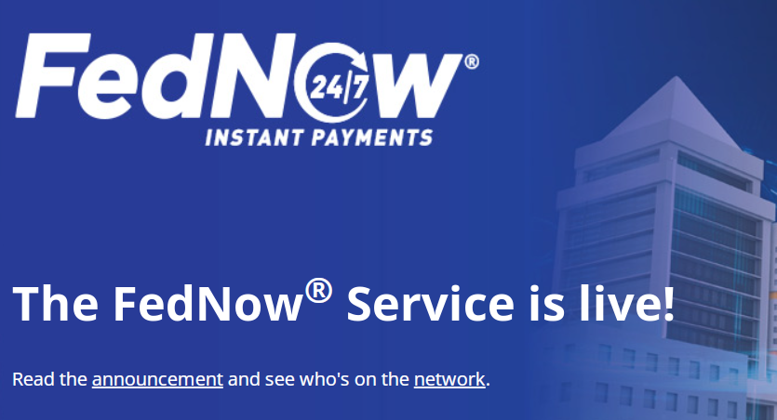
FedNow Instant Payment System: Laying the Foundation for a US CBDC
The Federal Reserve launched a digital payment system, FEDNOW, in July 2023, that is the foundation and infrastructure that would support a CBDC in the US.
From the website: “The FedNow Service is a new instant payment infrastructure developed by the Federal Reserve that allows financial institutions of every size across the U.S. to provide safe and efficient instant payment services.”
“Through financial institutions participating in the FedNow Service, businesses and individuals can send and receive instant payments in real time, around the clock, every day of the year. Financial institutions and their service providers can use the service to provide innovative instant payment services to customers, and recipients will have full access to funds immediately, allowing for greater financial flexibility when making time-sensitive payments.”
https://www.frbservices.org/financial-services/fednow/about.html

Slide 17
What would a US CBDC look like? “Synthetic” CBDC vs. “Direct Issue” CBDC
Federal Reserve Chairman, Jerome Powell confirmed in September 2022 during an event hosted by the Bank of France that CBDCs would not be anonymous: He stated:
“If we were to pursue a CBDC, it would at a minimum have the following four characteristics,... First is intermediated. Second is privacy protected. But third is identity verified. So, it would not be anonymous. It would not be an anonymous bearer instrument. And fourth is transferable or interoperable. So, we would be looking to balance privacy protection with identity verification, which has to be done, of course, in today's traditional banking system.”
Intermediation: “Synthetic” CBDC in the form of stable coins/deposit tokens issued by a major bank (ie, JP Morgan Chase)
CBDCs would still be fully traceable, programmable and tied to your digital ID, meaning that every transaction would still be recorded, monitored, programmed and controlled by the major bank on behalf of the Federal Reserve.
Notes:
Criminalization of privacy-enhancing tools for BTC, because they want to eliminate financial privacy of any sort. They don’t want you so spend $1 and them not know about it.
(ex. The prank call to Christine LaGarde in which she stated that anonymous 300-euro transactions could be dangerous)

Slide 18
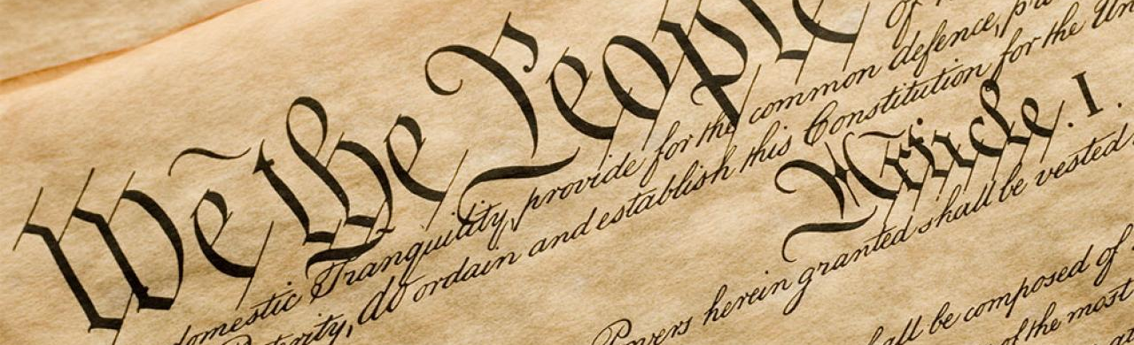
United States Constitution: Fourth Amendment
The right of the people to be secure in their persons, houses, papers, and effects, against unreasonable searches and seizures, shall not be violated, and no Warrants shall issue, but upon probable cause, supported by Oath or affirmation, and particularly describing the place to be searched, and the persons or things to be seized.

Slide 19
The European Central Bank (ECB): Digital Euro is Now in the Preparation Stage As of November 1, 2023
Per the ECB’s 10/18/2023 press release: ““[T]he ECB has designed a digital euro that would be widely accessible to citizens and businesses through distribution by supervised intermediaries, such as banks.
“The design envisages the digital euro as a digital form of cash that could be used for all digital payments throughout the euro area. It would be widely accessible, free for basic use and available both online and offline. It would offer the highest level of privacy and allow users to settle payments instantly in central bank money. It could be used from person to person, at the point of sale, in e-commerce and in government transactions.”
The ECB has signaled that THERE WILL BE CONTROL. In the same press release, the ECB stated that there will be limitations on the amounts of Digital Euros that individuals or businesses may hold in their digital wallets. Page 12 of the summary report that was issued at the conclusion of the investigation stage states, “Holding limits were identified as an effective tool and would therefore be included in the design of a digital euro.” Those limits will prevent the accumulation or saving of the digital euros.
Notes:
Announced on 10/18/2023

Slide 20
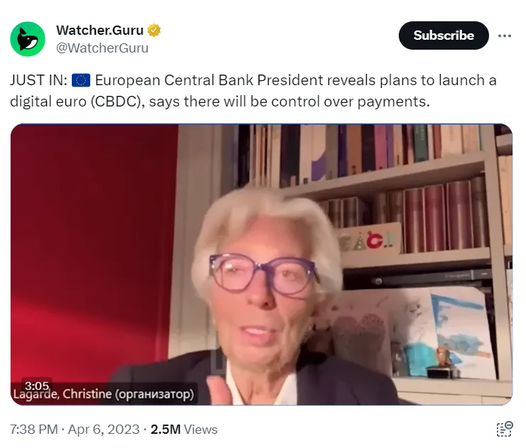
The European Central Bank (ECB): Now in the Preparation Stage for a Digital Euro – Will Europeans Be Able to Continue to Use Cash, and For How Long?
Although President Lagarde said in her video announcement that “Cash is here to stay,” “You will have all options: cash and digital cash,” and “Cash or digital, the choice will be yours”, she has also been caught on video in a prank call, acknowledging that spending more than 1,000 Euros in cash is already illegal and puts you on the “gray market,” subject to fines and/or arrest, and went even further to state that she feels that it is “dangerous” to permit an individual to spend 300 or 400 euros in cash in total anonymity.
Notes:
https://x.com/WatcherGuru/status/1644122520478445570?s=20

Slide 21
TOKENIZATION OF PRIVATE ASSETS ON the GLOBAL UNIFIED LEDGER

Slide 22
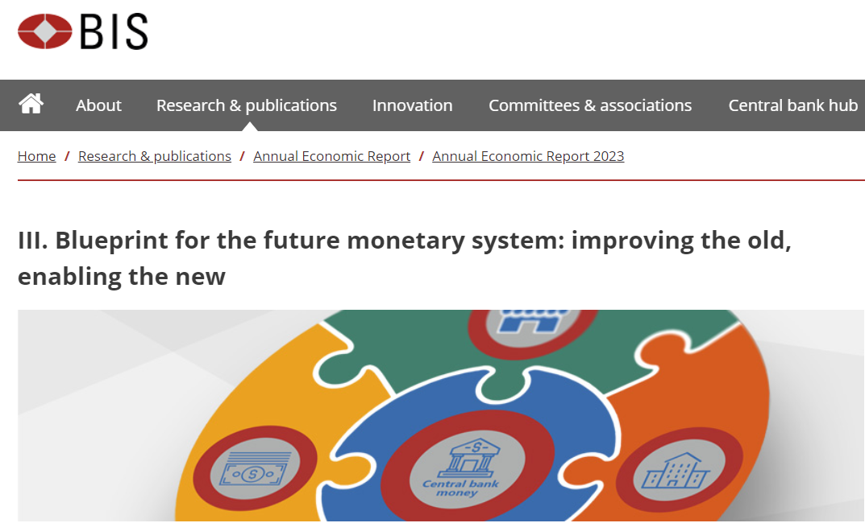
BIS Plan To Tokenize All Privately-Held Assets on a Global Unified Ledger
On June 20, 2023, the Bank of International Settlements (BIS) released a chapter of its annual report titled, “Blueprint for the future monetary system: improving the old, enabling the new.”
Notes:
https://www.bis.org/publ/arpdf/ar2023e3.htm

Slide 23
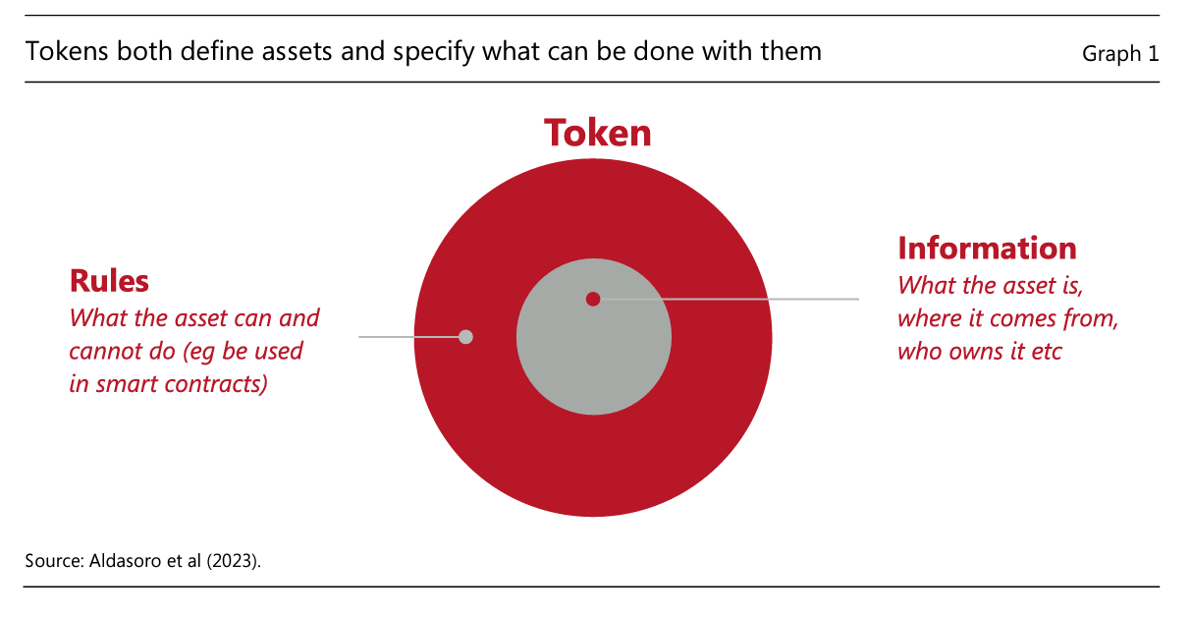
BIS Plan To Tokenize All Privately-Held Assets on a Global Unified Ledger
Per the BIS report: “… in a tokenised setting, money or assets become ‘executable objects’ that are maintained on programmable platforms…. Tokens are not merely digital entries in a database. Rather, they integrate the records of the underlying asset normally found in a traditional database with the rules and logic governing the transfer process for that asset.”
Notes:
https://www.bis.org/publ/arpdf/ar2023e3.htm
A reading of the 34-page report, reveals that the programmability of the platform, unified ledger, and digital currency, as well as the tokenization of all privately-held assets, and centralization of those privately-held assets in a unified ledger, are the key aspects of their plan that will enslave the world in a unified system of control by the government and/or the Central Bank.

Slide 24
BIS Plan To Tokenize All Privately-Held Assets on a Global Unified Ledger
The report defines “tokenization” as “the process of recording claims on financial or real assets that exist on a traditional ledger on a programmable platform.”
The report states that the “data environment” of this unified ledger would encompass all tokenized assets plus “all information necessary to incorporate real-world events into any contingent performance of actions.” Thus, the unified ledger would not just store tokenized versions of every piece of private property on the planet, but every piece of information from real-world events that could possibly impact assets or transactions on the global unified ledger.
Notes:
https://www.bis.org/publ/arpdf/ar2023e3.htm
If you do not worship the beast on Sunday, you could lose ownership of your assets instantly.

Slide 25
David Rogers Webb and The Great Taking
https://thegreattaking.com/

Slide 26
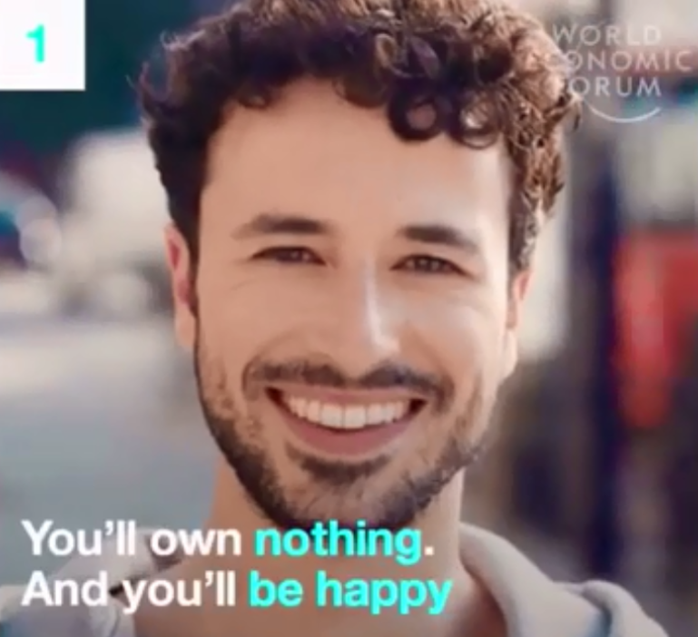
How many of you have heard this phrase from the WEF (World Economic Forum)?
CBDCs, the tokenization of all private property, securities and bank deposits on a Global Unified Ledger, and the mechanisms and legal changes described in The Great Taking, is how the central banks could accomplish this.

Slide 27
WHAT CAN WE DO?

Slide 28
Have a Means of Food Production and Learn Foraging Skills
There are many native plants that are readily available around us that are safe to eat, nutritious, and have medicinal properties.
There are many helpful books on this subject.

Slide 29
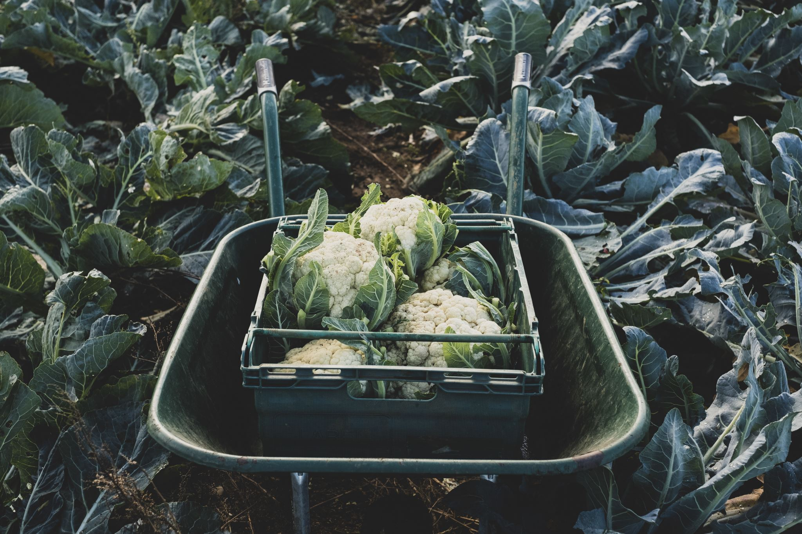
Find and Buy Food From a Local Farmer
Find and make relationships with local farmers. Buy your food from a local farmer. The least dependent that you can be on the major supermarket chains, the better off you will be.
When times get tough, you may be able to barter with your local farmer.
Start growing a garden!

Slide 30
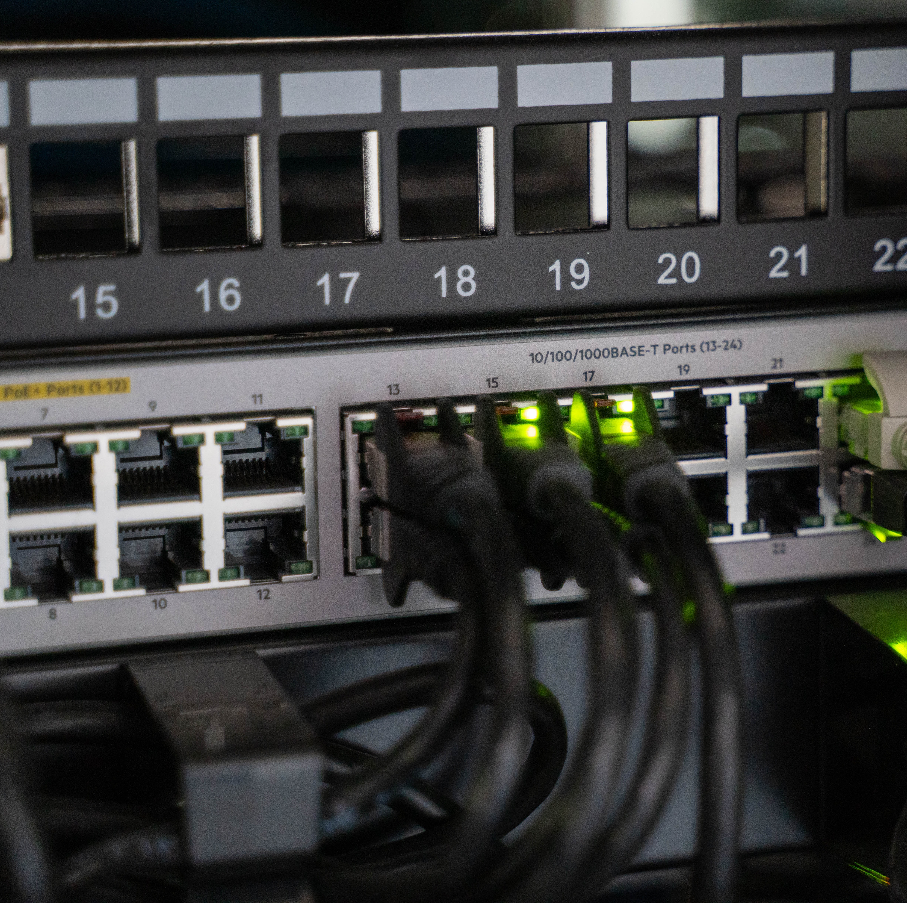
Get off Wifi and Hard-Wire Your Home
Get rid of your wifi router and hardwire your home for your internet.
Your internet access will be faster.
Your health will be improved, since wifi routers constantly emit EMFs which damage your cells and negatively impact your health over time.

Slide 31
Throw Out Your Smart TV
Get rid of your smart TV. If you must have a television, find an older, non-smart TV.
The Smart TV terms and conditions have provisions whereby you give them permission to photograph and film you in your home.
The more we can make it more difficult for Big Brother to spy on us via our technological devices, the safer we will be.

Slide 32
Avoid Using or Becoming Reliant on the Controls…
Avoid being reliant on the control grid elements as much as possible. These elements are:
CBDCs.
Digital IDs
Vaccine Passports
Non-cash methods of payment
These controls will destroy our sovereignty as individuals. If, and when, they destroy our sovereignty, the speed at which they can take away the rest of your assets or squeeze you economically will accelerate EXTREMELY quickly.

Slide 33
It is time to awaken and prepare and be ready watchmen
Romans 13:11 (KJV):
¹¹ And that, knowing the time, that now it is high time to awake out of sleep: for now is our salvation nearer than when we believed.
Notes:
We all need now to have and to continue to develop a sincere relationship with CHRIST.
Without the infilling of HIS HOLY SPIRIT, we will deny HIM like Peter. But with the HOLY SPIRIT, we, like Peter, will be able to stand for GOD regardless of persecution.

Slide 34
Do we put our trust in money to be safe?
“Lay not up for yourselves treasures upon earth, where moth and rust doth corrupt, and where thieves break through and steal.”
Matthew 6:19

Slide 35
What about our food? 1 Kings 17:2-6
Look at how God provided for Elijah:
“² And the word of the Lord came unto him, saying,
³ Get thee hence, and turn thee eastward, and hide thyself by the brook Cherith, that is before Jordan.
⁴ And it shall be, that thou shalt drink of the brook; and I have commanded the ravens to feed thee there.
⁵ So he went and did according unto the word of the Lord: for he went and dwelt by the brook Cherith, that is before Jordan.
⁶ And the ravens brought him bread and flesh in the morning, and bread and flesh in the evening; and he drank of the brook.”

Slide 36
How do we show our love to God?
“If ye love me, keep my commandments.”
John 14:15

Slide 37
Do not be afraid. God does not want us to have a spirit of fear.
“These things I have spoken unto you, that in me ye might have peace. In the world ye shall have tribulation: but be of good cheer; I have overcome the world.”
John 16:33
Notes:
We need to prepare ourselves to receive the seal of God and not the mark of the beast, and we need to be ready to meet Jesus.

Slide 38
Q&A
Notes:
…

