Slide 1
H
Sermon title: Christ our Righteousness
Scripture: Romans 3:22-25
Opening Hymn: Turn Your Eyes on Jesus(290)
Closing Hymn: I will follow thee (623)
Dates Given: 10/11/2025 Mqt.

Slide 2

Christ Our Righteousness
Click speaker icon to test audio
Notes:
[Set laptop audio to max when testing so can lower from laptop.]

Slide 3

Christ Our Righteousness
Brief Background
Prior to the 1888 Conference, two gentlemen (Alphozo “A. T.” Jones & E. J. Waggoner) began studying separately under the direction of the Holy Spirit about Christ and His plan of Salvation.
Prior to the conference, the met each other and together honed their message.
Both spoke at the 1888 conference, and their message is now known as Righteous By Faith.
Notes:
[Read slide]

Slide 4
Christ Our Righteousness
Brief Background
This message of Righteous By Faith totally divided the 1888 Conference.
This division became so severe that it prevented the Lord from returning after the conference because He could not find enough people ready to carry this message to a dying world.
This message was also identified by Ellen White as “the Third Angel’s message in verity.”
Notes:
[Read slide]
This is God’s last message which we, the Seventh-Day Adventist church, have been called to give to a dying world.

Slide 5
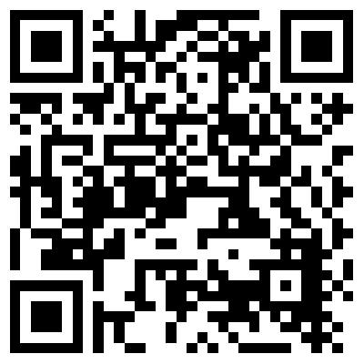
Christ Our Righteousness
QR Code to order from Amazon
Order from Amazon Download book PDF
Notes:
[Recommend book and cite QR to order from Amazon]

Slide 6
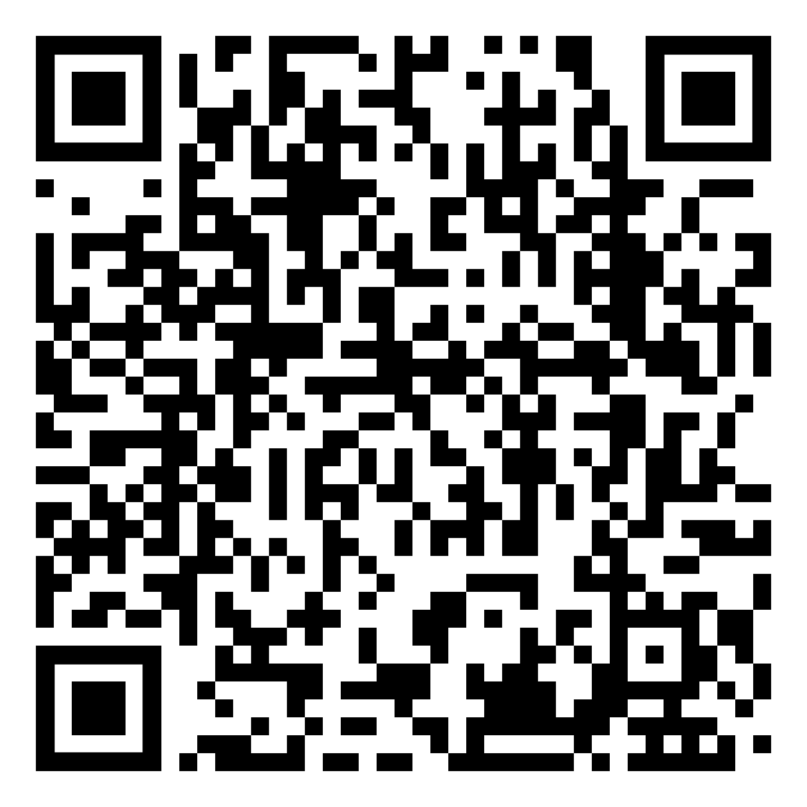
Christ Our Righteousness
QR Code to download presentation PDF
Notes:
Point your camera at the icon do download a readable PDF version of the presentation.
Note that the PDF includes both presenter instructions as well presenter text
Also, the presentation PDF may vary slightly from what is presented.

Slide 7
Christ Our Righteousness
Foreword (Excerpts)
“At a meeting of the members of the Ministerial Association Advisory Council, held in Des Moines, Iowa, Oct. 22, 1924, it was voted that Elder Daniells [retired General Conference President] be asked to arrange for a compilation of the writings of Mrs. E. G. White on the subject of Justification by Faith.”

Slide 8
Christ Our Righteousness
Foreword (Excerpts)
“In harmony with the primary purpose of providing a ‘compilation of the writings of Mrs. E. G. White on the subject,’ exhaustive research was made through all the writings of the Spirit of prophecy as held in trust by us as a people, in bound volumes and also in printed articles appearing in the files of our denominational papers, covering a period of twenty-five years from 1887 to 1912.” (A. G. Daniels)

Slide 9
Christ Our Righteousness
Foreword (Excerpts)
“So vast was the field of study opened up, so marvelous and illuminating the hidden gems of truth which came to light, that I became amazed and awed at the solemn obligation resting upon me, of rescuing these gems from their obscurity, and placing them, in a cluster of brilliancy and beauty, where they would win rightful recognition and acceptance in the glorious finishing of the work entrusted to the remnant church.”
Notes:
[Read slide]
All the signs point to the soon beginning of the great troubles that will precede the Lord’s second coming.
Therefore, we need to be sure that we understand this message and that is why I’m here today.
All are called to enter the battle and hasten the Lord’s return!
Consider
[Next]

Slide 10
Why Study
Christ Our Righteousness
The message of Christ our righteousness is the single most important topic in the church. It is absolutely necessary and urgent that we understand it so we can “stand” in these last days.
Again, note that it was the message by Jones and Waggoner in 1888 (called “the three angel’s message in verity” by Ellen White.)
Failure to understand this message and reflect it in our character can cost us heaven! This is Christ’s warning to us the Seventh-Day Adventist Church as written in the Laodicean message!
Notes:
[Next]
[Next]
[Next]
[Read last bullet again]
We will outline the warning in the Laodicean message here only briefly. I will cover it in detail in a later message.

Slide 11
Christ Our Righteousness¹ Chapter 1
“Christ our righteousness is the one sublime message set forth in the Sacred Scriptures. However, varied the forms and phrases in which this message may be unfolded and presented, yet always, from every point of the circle, the central commanding theme is, Christ our righteousness.”
¹Taken from Christ our Righteousness by A. G. Daniels. Gerald E. Greene 2015. Page 15

Slide 12
Christ Our Righteousness Chapter 1
“Throughout the Sacred Volume, – every phase of truth unfolded, points in some way to Christ as our righteousness. But righteousness as a distinct, well-defined subject of vital importance, occupies a large place in the word of God. Its source, its nature, the possibility of its being obtained by sinners, and the conditions upon which it may be secured, are set forth in great clearness in that original, authoritative textbook (the Bible) on righteousness.”
Notes:
[Read Slide First]
Let’s look at Bible references as to source for this Righteousness.

Slide 13
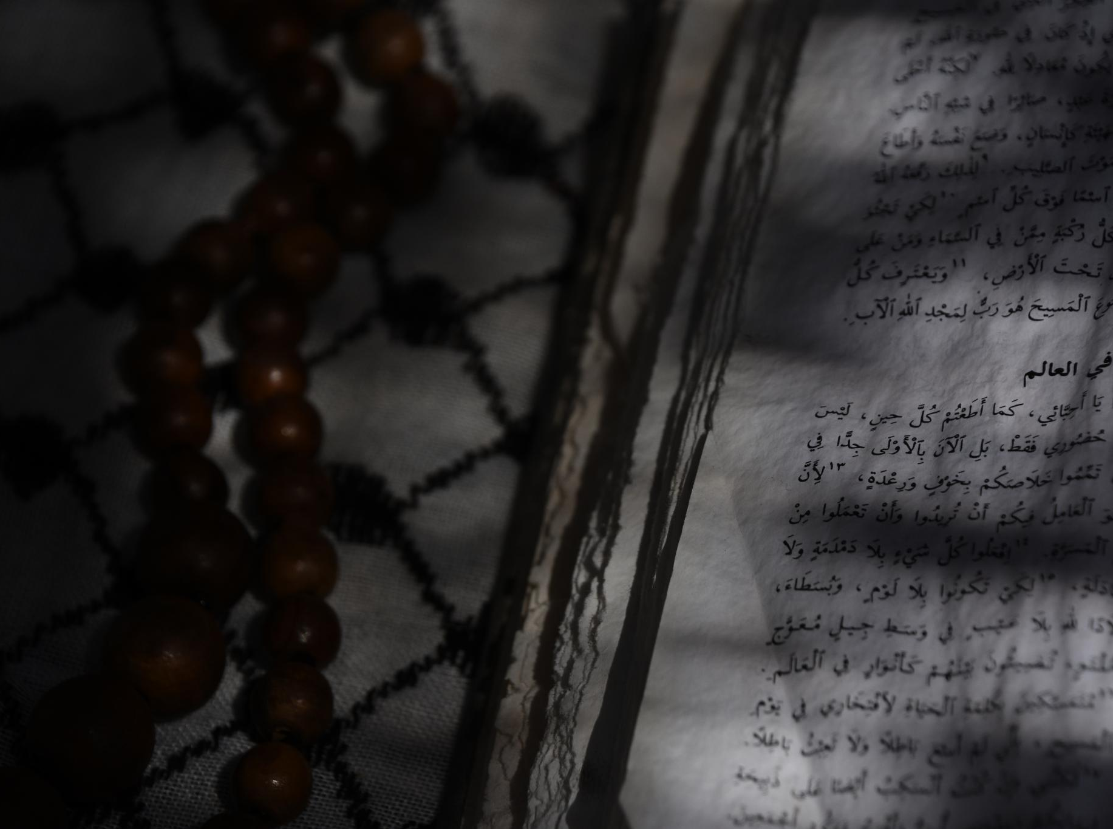
The message of Christ Our Righteousness as the core theme of Scripture
Source of Righteousness
"O Lord, righteousness belongs unto Thee”
(Daniel 9:7)
"The Lord is righteous in all His ways." (Psalm 145:17)
"Thy righteousness is like the great mountains."
(Psalm 36:6.)
Notes:
[Next 3 times]
[Next to more on next slide]

Slide 14
The message of Christ Our Righteousness as the core theme of Scripture
Source of Righteousness
"Thy righteousness is an everlasting righteousness.“ (Psalm 119:142)
"The righteous Lord loveth righteousness."
(Psalm 11:7)
"There is no unrighteousness in Him." (Psalm 92:15)
Notes:
[Next 3 times]
[Next to summary]

Slide 15
The message of Christ Our Righteousness as the core theme of Scripture
Source of Righteousness
Thus, God is the source of all righteousness; it is one of His holy, divine attributes.
Notes:
[Next]
Now let’s examine the nature of righteousness…
[Next]

Slide 16
The message of Christ Our Righteousness as the core theme of Scripture
Nature of Righteousness
"That you put away, as concerning your former manner of life, the old man, which waxes corrupt after the lusts of deceit; and that you be renewed in the spirit of your mind, and put on the new man, which after God hath been created in righteousness and holiness of truth." (Ephesians 4:22-24, R. V.)
Notes:
[Next]

Slide 17
The message of Christ Our Righteousness as the core theme of Scripture
Nature of Righteousness
"The fruit of the Spirit is in all goodness and righteousness and truth." (Ephesians 5:9)
"Follow after righteousness, godliness, faith, love, patience, meekness." (1 Timothy 6:11)
"Awake to righteousness, and sin not."
(1 Corinthians 15:34)
Notes:
[Next]
[Next]
[Next]
[Next]

Slide 18
The message of Christ Our Righteousness as the core theme of Scripture
Nature of Righteousness
"Thou hast loved righteousness and hated iniquity; … “ (Hebrews 1:9)
"All unrighteousness is sin."
1 John 5:17.
Notes:
[Next]
This last one gives us a precise definition.
[Next]
Let me summarize this way.
[Next]

Slide 19
The message of Christ Our Righteousness as the core theme of Scripture
Nature of Righteousness
Righteousness is thus the antithesis, the direct opposite of iniquity or sin.
Notes:
[Read slide]
Let’s dig a little deeper into how this impacts our lives.
[Next]

Slide 20
What does this mean in our lives as believers?
Digging a little deeper:
What is our personal relation to that righteousness?
Is righteousness in any degree inherent in human nature?
If so, how may it be cultivated and developed?
If it is not inherrent, is there any way of obtaining it?
If it is obtained, by what means, and when?
Notes:
[Next 5 times to “…If it is obtained…]
So, what says the Word?

Slide 21

The significance of righteousness as revealed in the Word of God
Is Righteousness Inherent In Us?
“All have sinned and come short of the glory of God. (Romans 3:23)
“We are carnal, sold under sin.“ (Romans 7:14)
“There is none righteous, no, not one”
(Romans 3: 10);
Notes:
Is righteousness inherent in us?
[Next 3 times]

Slide 22
The significance of righteousness as revealed in the Word of God
Is Righteousness Inherent In Us?
“For I know that in me (that is, in my flesh,) dwelleth no good thing:” (Romans 7:18)
”We are filled with all unrighteousness.” (Romans 1:29).
Clearly, human nature is filled with all unrighteousness.
Notes:
[Next]
[Next]
Do you see a pattern? Let me express it this way
[Next]
Bottom line, there is not a single trace of goodness in us that God has not given us.
Now let’s examine the question if anyone can be righteous
[Next]

Slide 23

What do the scriptures say?
Christ refers to the second son of Adam and speaks of him as “righteous Abel.”
(Matt. 23:35).
Paul declares that Abel "obtained witness that he was righteous." (Hebrews 11:4).
“The Lord said unto Noah, Come thou and all thy house into the ark; for thee have I seen righteous before Me in this generation.” (Genesis 7:1).
Therefore, is it possible for anyone to be righteous?
Notes:
Is it possible for anyone to be righteous?
[Next 3 times]
[Next for more comments]

Slide 24
What do the scriptures say?
"Noah was a just man and perfect in his generations…“ (Genesis 6:9).
"Abraham believed God, and it was counted unto him for righteousness." (Romans 4:3)
"And delivered righteous Lot, sore distressed by the lascivious life of the wicked (for that righteous man dwelling among them, in seeing and hearing, vexed his righteous soul from day to day with their lawless deeds)." (2 Peter 2:7, 8, R. V.)
Therefore, is it possible for anyone to be righteous?
Notes:
[Next 3 times]
[Next for more comments]

Slide 25
What do the scriptures say?
"Of Zacharias and Elisabeth, living just before the birth of Christ, it is said: "They were both righteous before God, walking in all the commandments and ordinances of the Lord blameless." (Luke 1:6).
The apostle Paul declares that the Gentiles to whom he had preached the gospel had "attained to righteousness." (Rom. 9:30; 6:17-22).
Therefore, is it possible for anyone to be righteous?
Notes:
[Next 2 times]
“But in this same word we find the good, glad news that God has provided a way by which we may be cleansed from our unrighteousness and be clothed and filled with His perfect righteousness. We find that this provision was made and revealed to Adam as soon as he fell from his high and holy estate. This merciful provision has been understood and laid hold of by fallen, unrighteous men and women from the very beginning of the fierce, unequal conflict with sin. This we learn from the following testimonies recorded in the Scriptures “

Slide 26

Therefore, is it possible for anyone to be righteous?
What do your say?
Notes:
[Pause]
So clearly the Bible has designated some righteous.
However, that answer brings up more questions.
[Next]

Slide 27
Why were these people declared righteous?
Possible answers:
Was it because the times and conditions in which these men and women lived were favorable to righteousness?
Was it due to the special and superior qualities inherent in those who reached the high tablelands of godliness?
All the records of the times and of individuals give a negative answer. They were people with natures like our own in an evil environment like our day.
Notes:
Why were these people declared Righteous?
[Next]
[Next]
[Next]
They were people with natures like our own in an evil environment like our day.
Now to the most important question: How are we made righteous?
[Next]

Slide 28

Therefore, by what means are we made righteous?
What do the scriptures say?
Not by works
"²⁰ By the deeds of the law [works] there shall no flesh be justified [accounted righteous] in His sight: for by the law is the knowledge of sin.” (Romans 3:20)
But by faith:
²¹ But now the righteousness of God without the law [works of the law] is manifested, being witnessed [approved, accepted] by the law and the prophets; ²² even the righteousness of God which is by faith of Jesus Christ unto all and upon all them that believe." (Romans 3:21-22).
Notes:
Therefore, by what means are we made righteous? [Next]
In the first part of this statement, the apostle shows the position which the law takes in the nature of justification. "By the law is the knowledge of sin." The knowledge of sin; not the deliverance from sin. The law points out sin. In so doing it declares the whole world to be guilty before God. (Romans 3) But the law cannot deliver from sin. No effort of the sinner to obey the law can cancel his guilt or bring to him the righteousness of God. [Next]
No! Paul clearly states that righteousness is by faith!
Now let’s examine other scriptural evidence.
[Next]

Slide 29
Therefore, by what means are we made righteous?
What do the scriptures say?
Not by works
“²³ For all have sinned and fall short of the glory of God.” (Romans 3:23)
But by faith:
²⁴ being justified freely by His grace through the redemption that is in Christ Jesus, ²⁵ whom God set forth as a propitiation by His blood, through faith, to demonstrate His righteousness, because in His forbearance God had passed over the sins that were previously committed." (Romans 3:24-25).
Notes:
[Read slide then below]
Again, not by works.
[Next]
“It is through faith in the blood of Christ that all the sins of the believer are canceled and the righteousness of God is put in their place to the believer's account. O, what a marvelous transaction! What a manifestation of divine love and grace. Here is a man born in sin. As Paul says, he is “filled with all unrighteousness”. His inheritance of evil is the worst imaginable. His environment is at the lowest depths known to the wicked. In some way the love of God shining from the cross of Calvary reaches that man's heart.”
[Next for more comments]

Slide 30
Therefore, by what means are we made righteous?
What do the scriptures say?
Not by works
“²³ For all have sinned and fall short of the glory of God.” (Romans 3:23)
But by faith:
²⁴ being justified freely by His grace through the redemption that is in Christ Jesus, ²⁵ whom God set forth as a propitiation by His blood, through faith, to demonstrate His righteousness, because in His forbearance God had passed over the sins that were previously committed." (Romans 3:24-25).
Notes:
“He yields, repents, confesses, and by faith claims Christ as his Savior. The instant that is done, he is accepted as a child of God. His sins are all forgiven, his guilt is canceled, he is accounted righteous, and stands approved, justified, before the divine law. And this amazing, miraculous change may take place in one short hour. This is righteousness by faith.”
[Read this again]
[Next and stop] { Alert: Read notes before pressing Next]

Slide 31
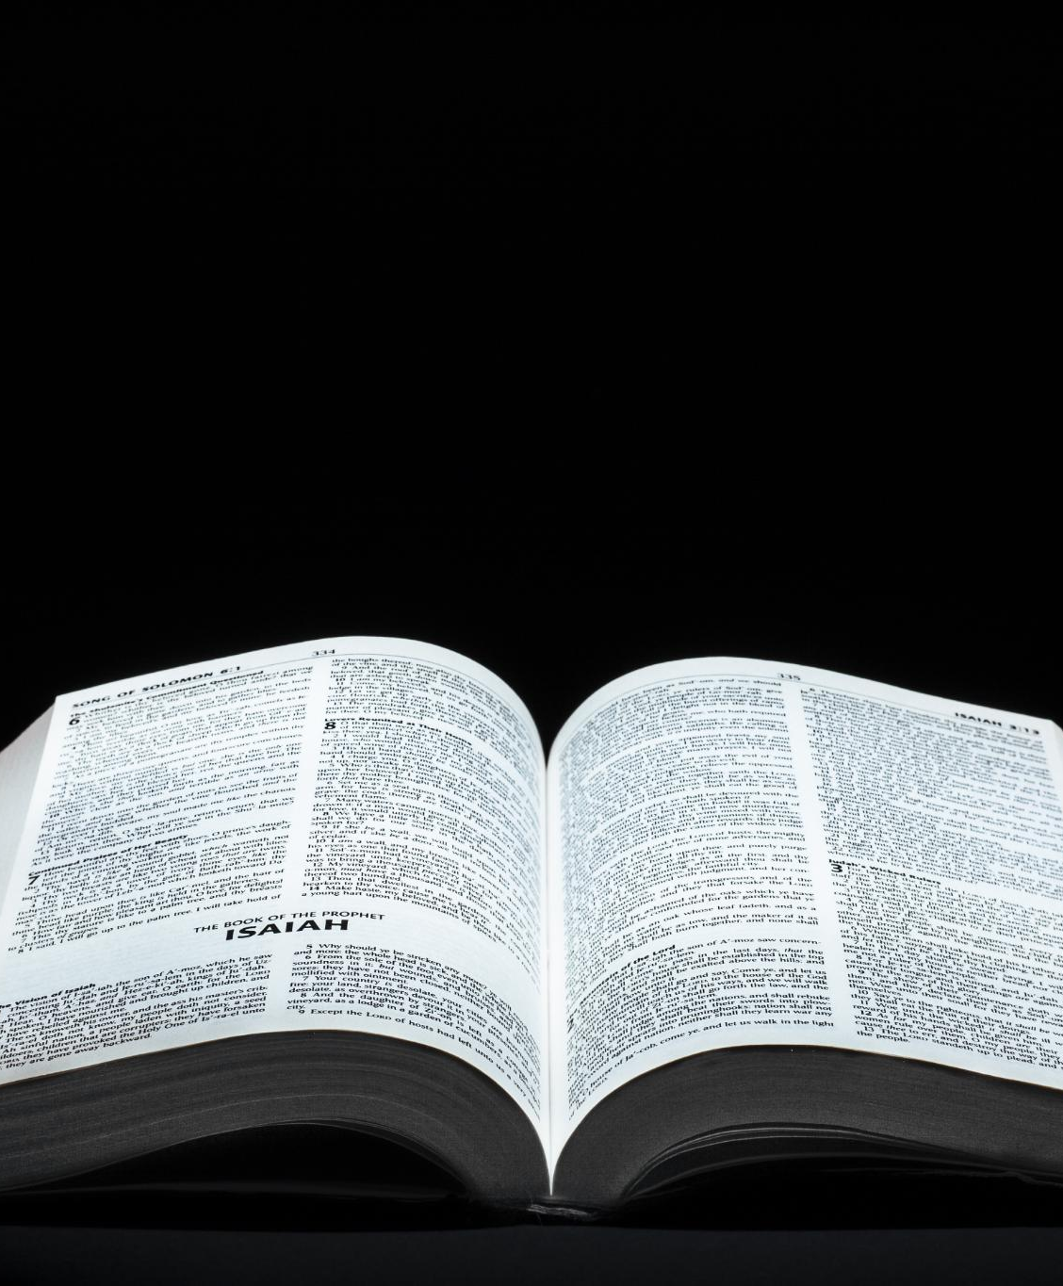
An example from the life of Abraham (Romans 4:1-4)
¹ What then shall we say that Abraham our father has found according to the flesh?
Not Works
² For if Abraham was justified by works, he has something to boast about, but not before God.
But Faith
³ For what does the Scripture say? “Abraham believed God, and it was accounted to him for righteousness.”
Not Works
⁴ Now to him who works, the wages are not counted as grace but as debt.
Notes:
[Read below first]
Having made these clear, forceful statements as to the way of being made righteous, the apostle then illustrates the truth declared by a concrete case. He takes the experience of Abraham as an example.
[Next vs 1]
[Next vs 2]
[Next vs 3]
[Next vs 4]
[Next for more comments]

Slide 32
An example from the life of Abraham (Romans 4:1-4)
¹ What then shall we say that Abraham our father has found according to the flesh?
Not Works
² For if Abraham was justified by works, he has something to boast about, but not before God.
But Faith
³ For what does the Scripture say? “Abraham believed God, and it was accounted to him for righteousness.”
Not Works
⁴ Now to him who works, the wages are not counted as grace but as debt.
Notes:
What kindness! What great compassion! The Lord, who is “righteousness in all His ways,” offers His own perfect righteousness to any and every poor, weak, helpless, hopeless sinner who will believe what He says. Reading again: "To him that worketh not, but believeth on Him, his faith is counted for righteousness."
[Next]

Slide 33
An example from the life of Abraham (Romans 4:21-25)
²¹ And being fully convinced that what He had promised He was also able to perform. ²² And therefore “it was accounted to him for righteousness.”
²³ Now it was not written for his sake alone that it was imputed to him, ²⁴ but also for us. It shall be imputed to us who believe in Him who raised up Jesus our Lord from the dead, ²⁵ who was delivered up because of our offenses, and was raised because of our justification.
Notes:
[Read below first]
So important, so fundamental is this way of righteousness that the apostle goes on through this entire chapter to restate and repeat and press home to all what he has made so clear in few words. Here are more of his statements:
[Next vs 21-22]
Fully convinced = faith
[Next vs 23]
This clear-cut, positive statement reveals to every lost soul for all time the only way from sin and guilt and condemnation to righteousness and deliverance from condemnation and death.
[Next for more comments]

Slide 34
An example from the life of Abraham (Romans 4:21-25)
²¹ And being fully convinced that what He had promised He was also able to perform. ²² And therefore “it was accounted to him for righteousness.”
²³ Now it was not written for his sake alone that it was imputed to him, ²⁴ but also for us. It shall be imputed to us who believe in Him who raised up Jesus our Lord from the dead, ²⁵ who was delivered up because of our offenses, and was raised because of our justification.
Notes:
[Slow with emphasis]
The three words “righteousness by faith” express the most wonderful transaction in this material world which the human intellect can grasp. They express the greatest gift that God, in His infinite plenitude, could bestow upon mankind. The great fact expressed by this phrase of three words, has been studied, expounded, and rejoiced in by millions during past ages, and it is still the theme of the most sublime interest and importance to the human family. With this agree all the other statements of the Scriptures regarding this great problem of being made righteous.

Slide 35

Warning
Many who think that their salvation is secure will miss heaven!
Reasons:
Seeking salvation by works of the law
Comfortable/complacent (Laodicea)
Notes:
This is a very serious warning
[Next]
I see two main reasons why members of the SDA church might miss heaven
[Next]
[Next]
Let’s look first at various warnings itself and then at the reasons for them.

Slide 36
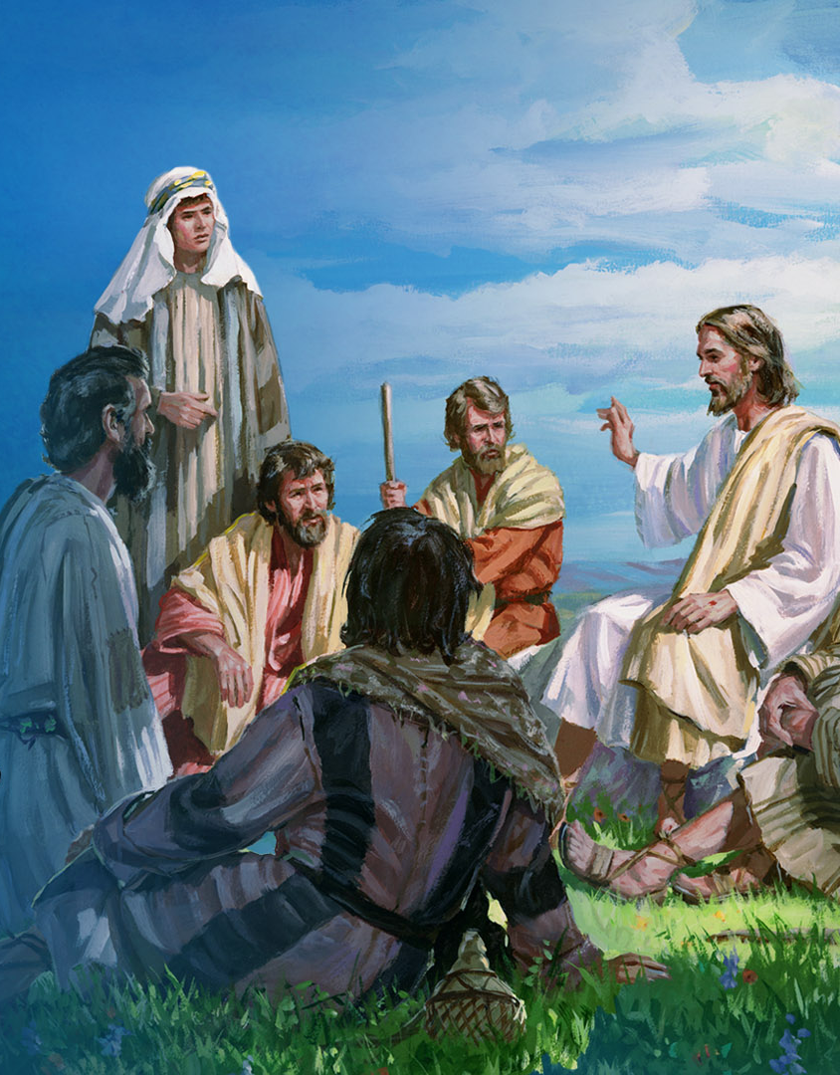
Warning
Christ’s Warning:
“Enter by the narrow gate; for wide is the gate and broad is the way that leads to destruction, and there are many who go in by it. ¹⁴ Because narrow is the gate and difficult is the way which leads to life, and there are few who find it. (Matthew 7:13-14)
Many who think that their salvation is secure will miss heaven!
Notes:
[Next]
[Read Slide]
What does “many” mean. What does “few” mean? How about “broad” versus “narrow” Here is an example from the book of Daniel.
[Next]

Slide 37
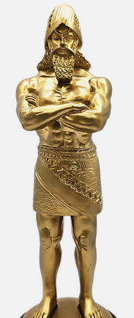
Warning
Many who think that their salvation is secure will miss heaven!
“¹ Nebuchadnezzar the king made an image of gold…⁵ That at the time you hear the sound of the horn, flute, harp, lyre, and psaltery, in symphony with all kinds of music, you shall fall down and worship the gold image that King Nebuchadnezzar has set up; ⁶ and whoever does not fall down and worship shall be cast immediately into the midst of a burning fiery furnace.” (Daniel 3:1, 5-6)
Notes:
[Next]
[Read Slide]
The 8,000 or so Hebrew captives were brought to Babylon for training as were Daniel and his three friends. Logically, if Daniel’s friends were invited, we can assume most of the 8000 would also have been invited to this celebration.
So, question? How many were left standing? [Pause]
So, under a death decree, only 3 of 8,000 were willing to stand up for their God. (About 0.04 percent).[Pause]
[Next for more comments]

Slide 38
Warning
Many who think that their salvation is secure will miss heaven!
“¹ Nebuchadnezzar the king made an image of gold…⁵ That at the time you hear the sound of the horn, flute, harp, lyre, and psaltery, in symphony with all kinds of music, you shall fall down and worship the gold image that King Nebuchadnezzar has set up; ⁶ and whoever does not fall down and worship shall be cast immediately into the midst of a burning fiery furnace.” (Daniel 3:1, 5-6)
Notes:
We don’t quite know how to measure what many and few mean but given the significance given this warning by Christ, we can assume that few might only be handfuls out of a crowd, even a cloud of “believers!”
Here is a frightening example from the book of Exodus.

Slide 39
Warning
A historical warning from Exodus:
“An estimated 500,000 adults came out of Egypt plus women and children.
How many families of that multitude are listed as remaining faithful?
Four: Moses, Aaron, Josuah & Caleb.
Question: What was the environment and culture in Egypt during their sojourn?
Many who think that their salvation is secure will miss heaven!
Notes:
[Next] [Read Slide]
[Next] [Read Slide]
[Next]
[Pause]
[Next]
So? Why? Conditions back in Egypt? [Pause for answers]
An evil pagan culture that worshiped idols.
Is our society very different? Our idols are money, power, fame, job, home, fancy car…) [Discuss]
Evil abounds. Are we in bondage today? Hmmm.
[Brief pause]
Let’s nail down the lid on the coffin of a works mentality.

Slide 40
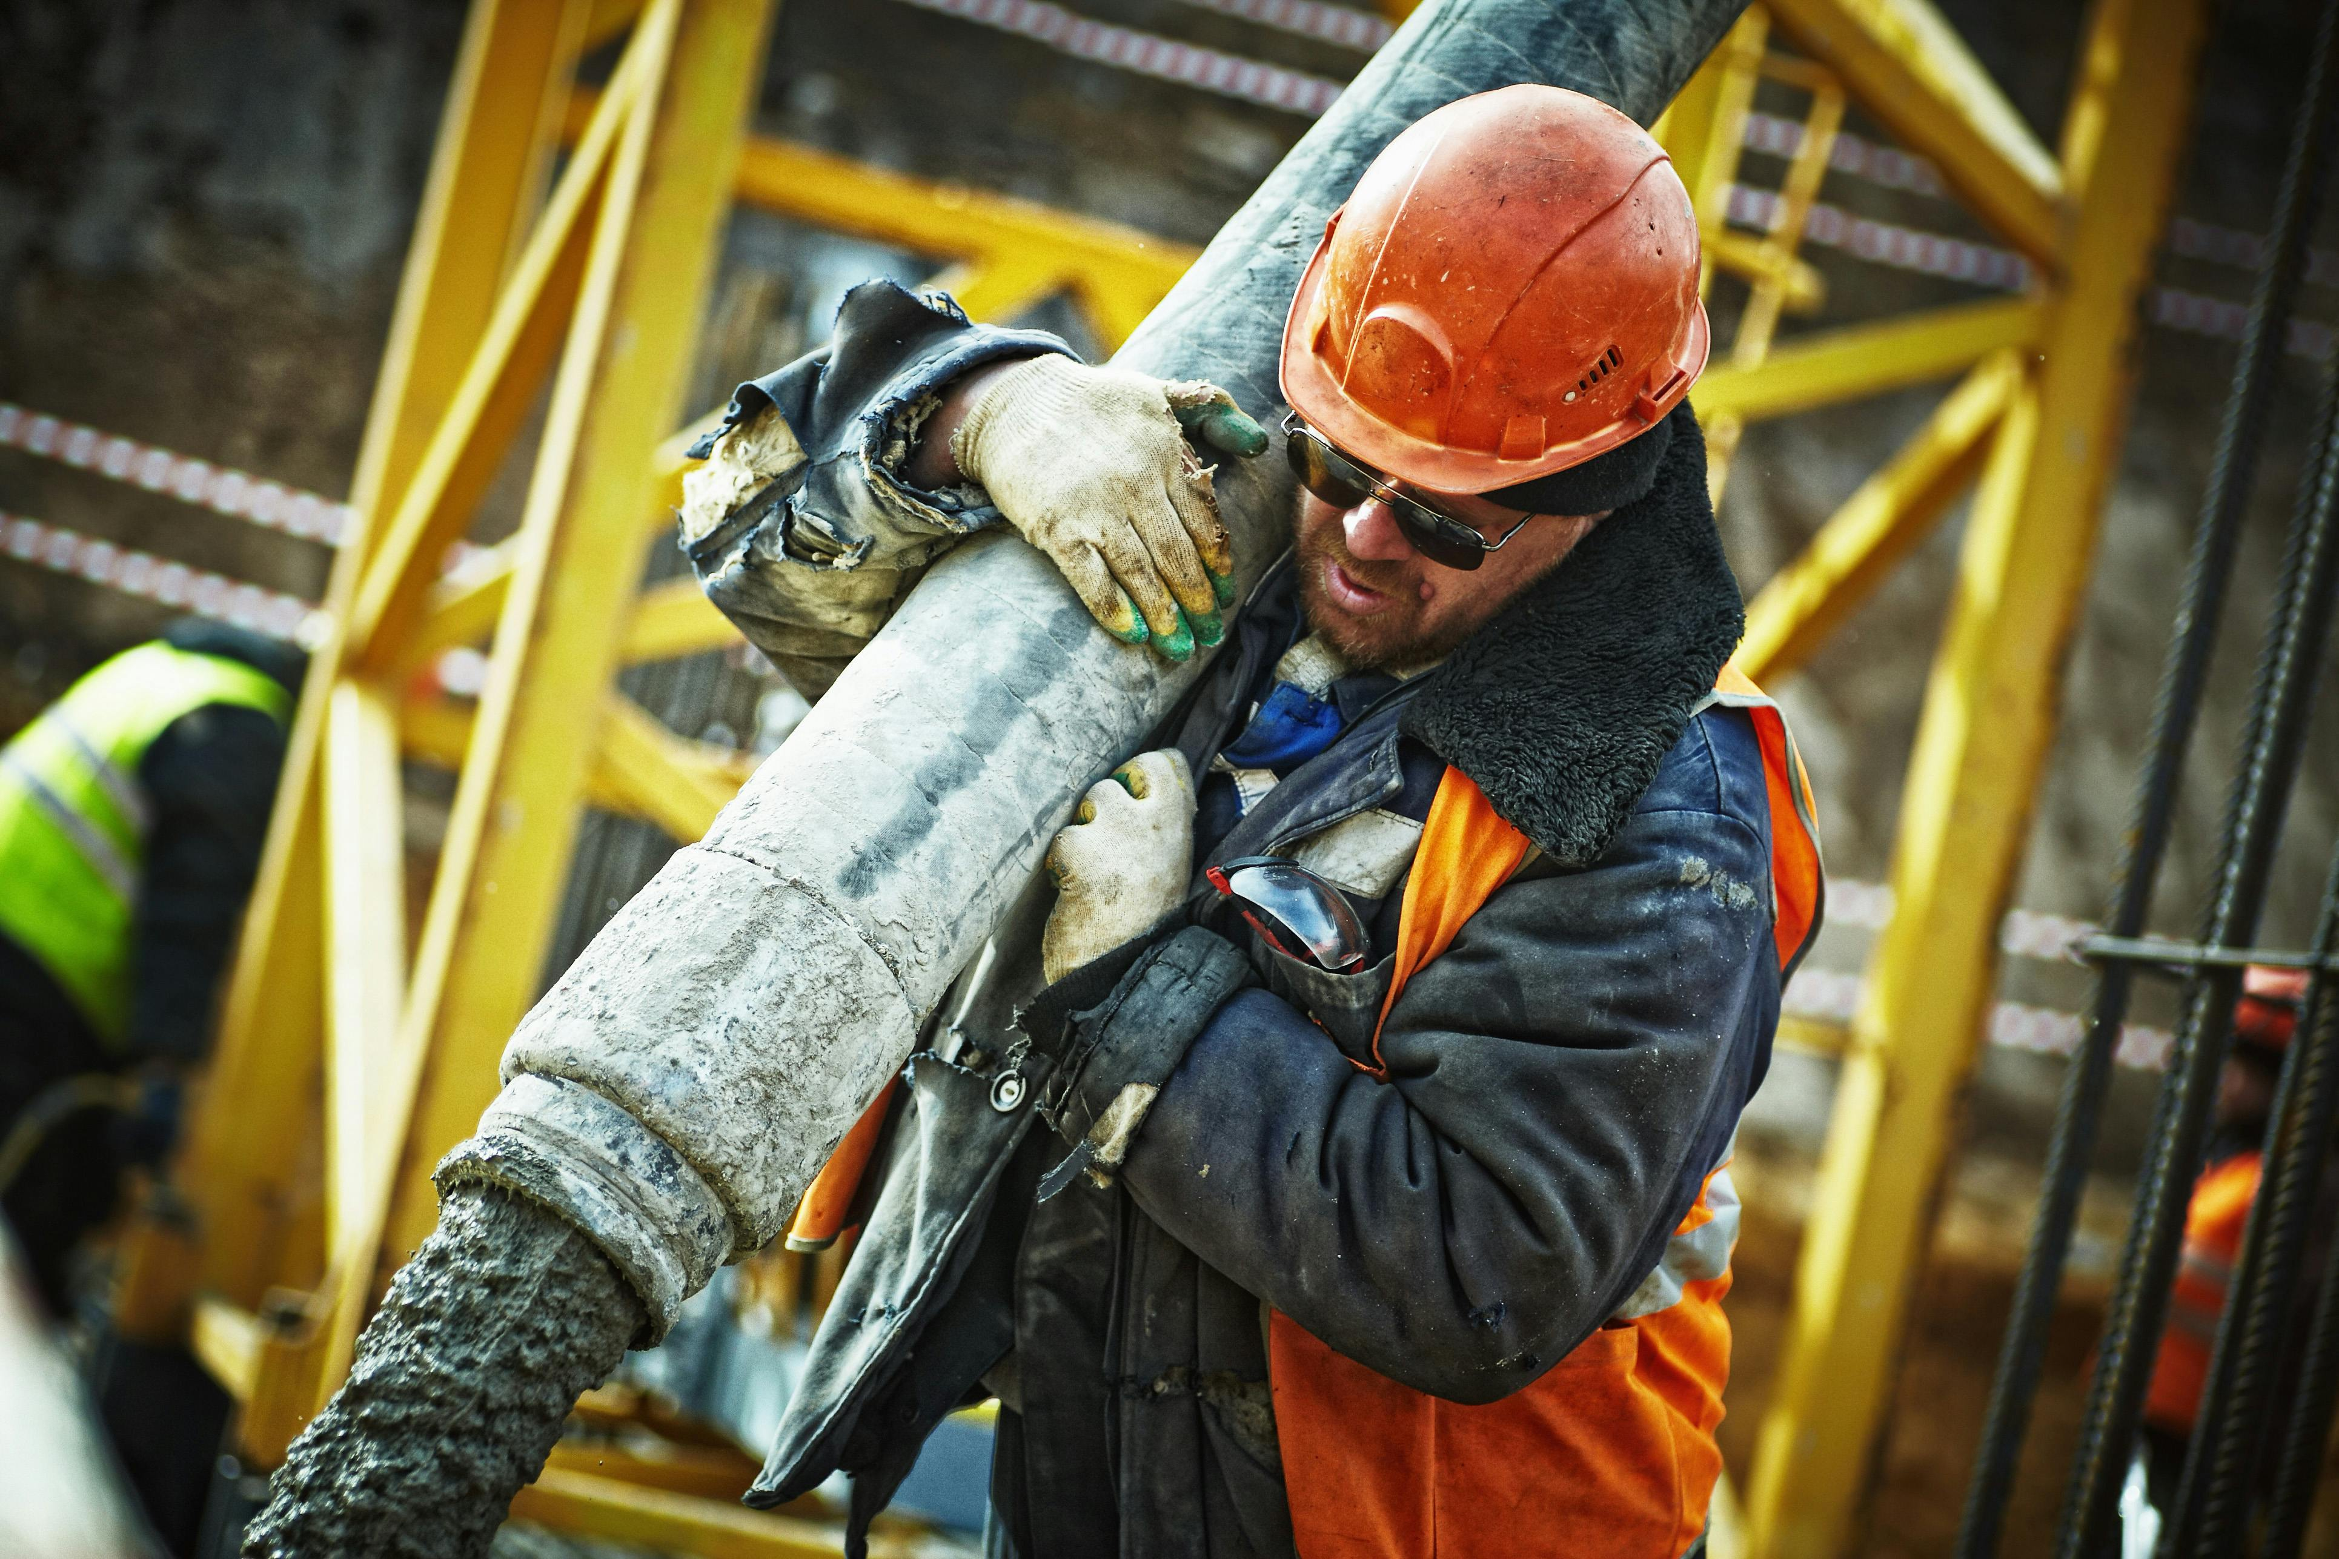
Warning
Seeking Salvation by Works
“⁸ For by grace are you saved through faith; and that not of yourselves: it is the gift of God; ⁹ Not of works, lest any man should boast.”
Think about it! We all know this scripture; how could we possibly fail here? Consider…
Many who think that their salvation is secure will miss heaven!
Notes:
[Next]
[Next][Discuss below]
Satan is very clever and frequently slips into this mindset.
A works mindset might manifest itself in several ways:
When we think we must do more good deeds to earn heaven.
When we try to do things in our own strength. “You’re busy Lord, I’ve got this.”
When we think we must do something good to offset some sin in our lives before we ask forgiveness.
When we choose to do our own thing though we know it’s not the Lord’s will (open rebellion).
There are more possibilities, but let’s look at an example:

Slide 41
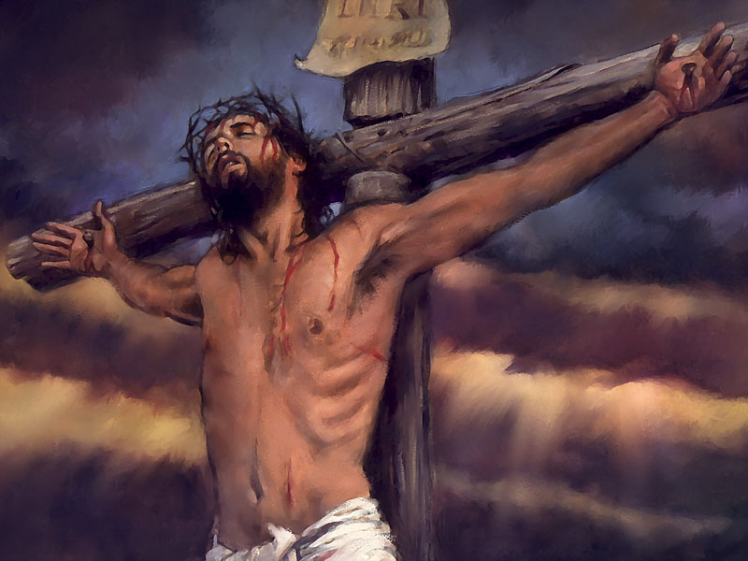

Warning
.
A Works of the Law Example from Israel in Christ’s Day
³¹ Israel, pursuing the law of righteousness, has not attained to the law of righteousness. ³² Why? Because they did not seek it by faith, but as it were, by the works of the law. For they stumbled at that stumbling stone.
³³ For they being ignorant of God’s righteousness, and seeking to establish their own righteousness, have not submitted to the righteousness of God. (Romans 9:31-33)
Notes:
[Read below first]
How strange and how sad that this simple, beautiful way of righteousness seems so hard for the natural, carnal heart to find and accept! It was a great sorrow to Paul that Israel, his kinsmen according to the flesh, missed the way so fatally.
[Next]

Slide 42
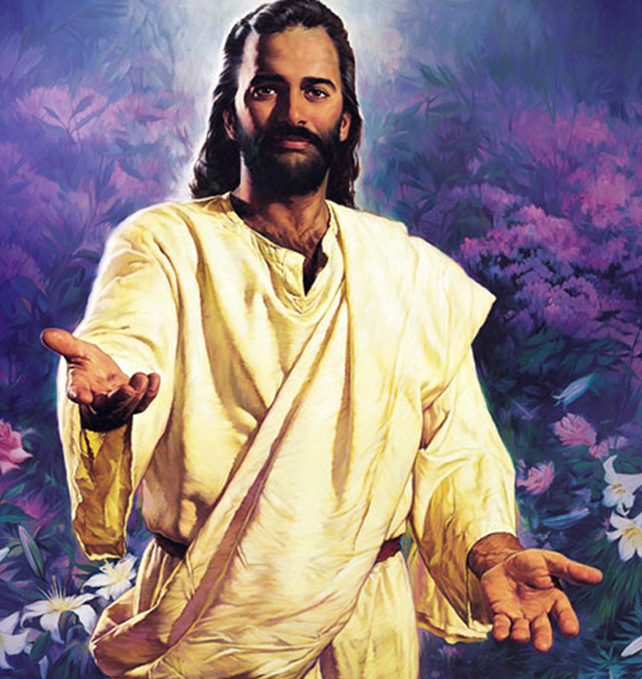
Warning
Laodicea/Comfortable
Letter to the Church of Laodicea:
¹⁵ “I know your works, that you are neither cold nor hot. I could wish you were cold or hot. ¹⁶ So then, because you are lukewarm, and neither cold nor hot, I will vomit you out of My mouth. ¹⁷ Because you say, ‘I am rich, have become wealthy, and have need of nothing’—and do not know that you are wretched, miserable, poor, blind, and naked.”
Many who think that their salvation is secure will miss heaven!
Notes:
I will discuss the letter to the Laodiceans in a later message but let’s just grab one phrase out of the letter
[Next; read highlighted only] DO NOT KNOW.
This is probably one of the most frightening words in the Bible. Do I know: Do I really know? Am I ready?
So, here is the key here is to fully understand Righteousness by Faith:
We can stand in the judgement only when we have received the righteous by Christ. This happens when we confess our sins, repent, and accept by faith Christ’s atoning sacrifice!
Any questions on this point?

Slide 43
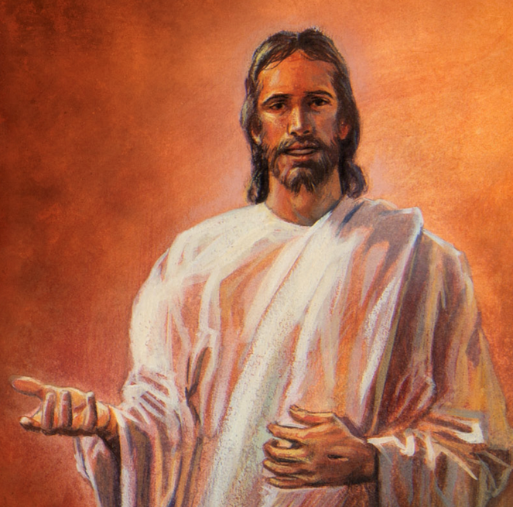
Final Thoughts from A. G. Daniels
"Righteousness by faith" is not a theory. People may hold a theory about it, and at the same time be “ignorant of God's righteousness and going about to establish their own righteousness.” “Righteousness by faith” is a transaction, an experience. It is a submitting unto “the righteousness of God.” It is a change of standing before God and His law. It is a regeneration, a new birth. Without this change there can be no hope for the sinner, for he will remain under the condemnation of God's changeless, holy law; its terrible penalty will still hang over his head.
Notes:
[Maximum emphasis]

Slide 44
Final Thoughts from Ellen White
"This name is hallowed by the angels of heaven, by the inhabitants of unfallen worlds. When you pray, 'Hallowed be Thy name,' you ask that it may be hallowed in this world, hallowed in you. God has acknowledged you before men and angels as His child; pray that you may do no dishonor to the 'worthy name by which ye are called.' God sends you into the world as His representatives. In every act of life, you are to make manifest the name of God. This petition calls upon you to possess His character. You cannot hallow His name, you cannot represent Him to the world, unless in life and character you represent the very life and character of God. This you can do only through the acceptance of the grace and righteousness of Christ." (Thoughts From the Mount of Blessing," P.158.)
Notes:
[Read Slide]

Slide 45
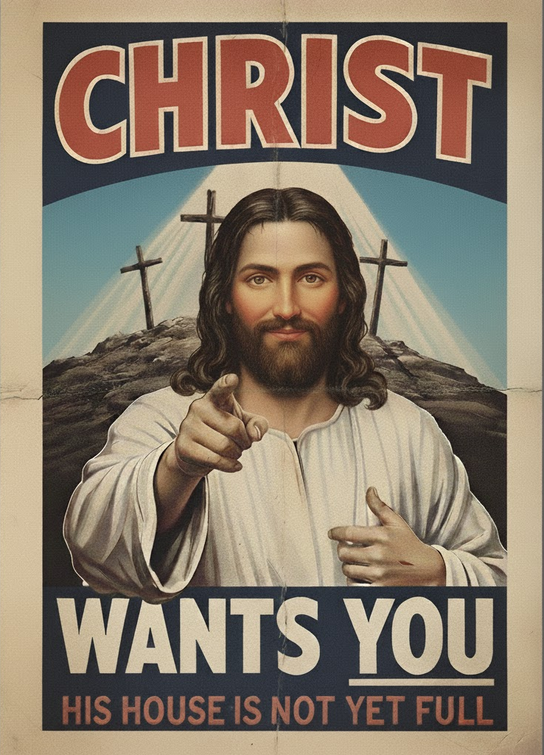
Final Thoughts from the Apostle Paul
“⁸ But what does it say? “The word is near you, in your mouth and in your heart” (that is, the word of faith which we preach): ⁹ …that if you confess with your mouth the Lord Jesus and believe in your heart that God has raised Him from the dead, you will be saved. ¹⁰ For with the heart one believes unto righteousness, and with the mouth confession is made unto salvation.”
Notes:
[Read highlighted only and repeat verse 9]

Slide 46
Final Thoughts from the Apostle Paul
²⁸ Come to Me, all you who labor and are heavy laden, and I will give you rest. ²⁹ Take My yoke upon you and learn from Me, for I am gentle and lowly in heart, and you will find rest for your souls. ³⁰ For My yoke is easy and My burden is light.”
Notes:
[Read highlighted only and repeat verse 9]

Slide 47
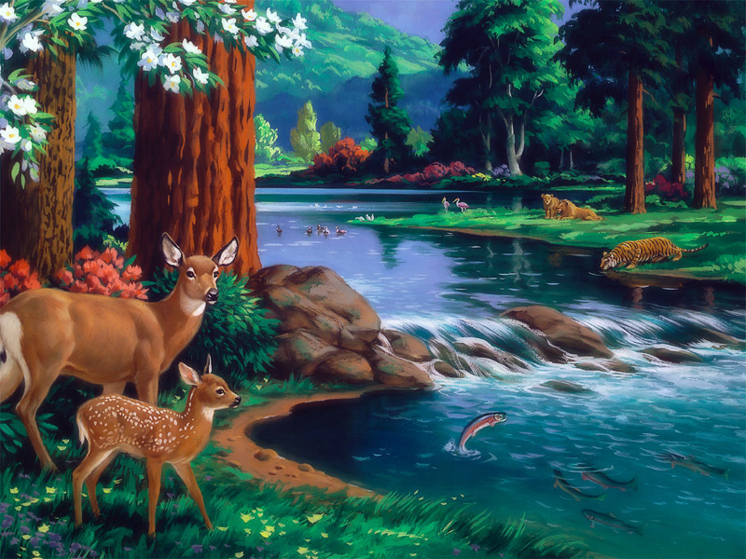
Notes:
“ But as it is written, Eye hath not seen, nor ear heard, neither have entered into the heart of man, the things which God hath prepared for them that love him.” (1 Cor. 2:9)

Slide 48
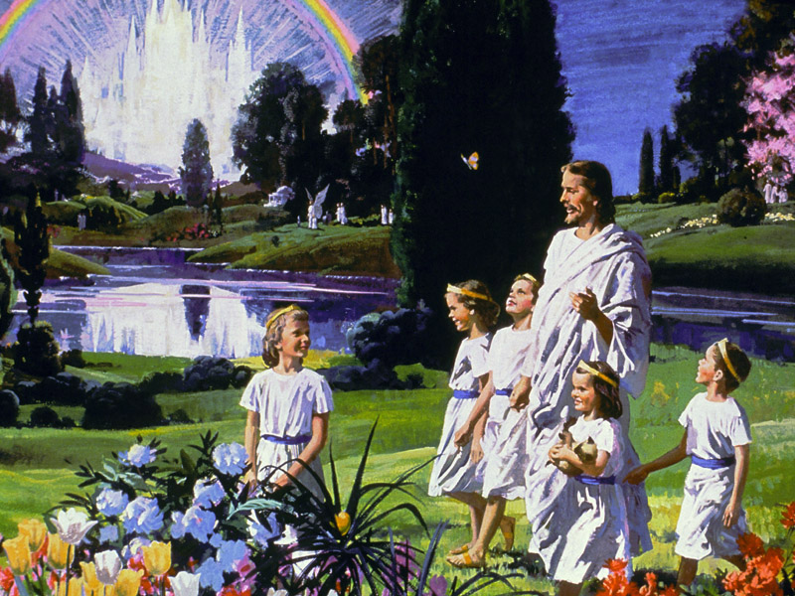
Notes:
“And I heard a loud voice from heaven saying, “Behold, the tabernacle of God is with men, and He will dwell with them, and they shall be His people. God Himself will be with them and be their God. ⁴ And God will wipe away every tear from their eyes; there shall be no more death, nor sorrow, nor crying. There shall be no more pain, for the former things have passed away.”
(Revelation 21:3-4)
So, is heaven worth it?

Slide 49
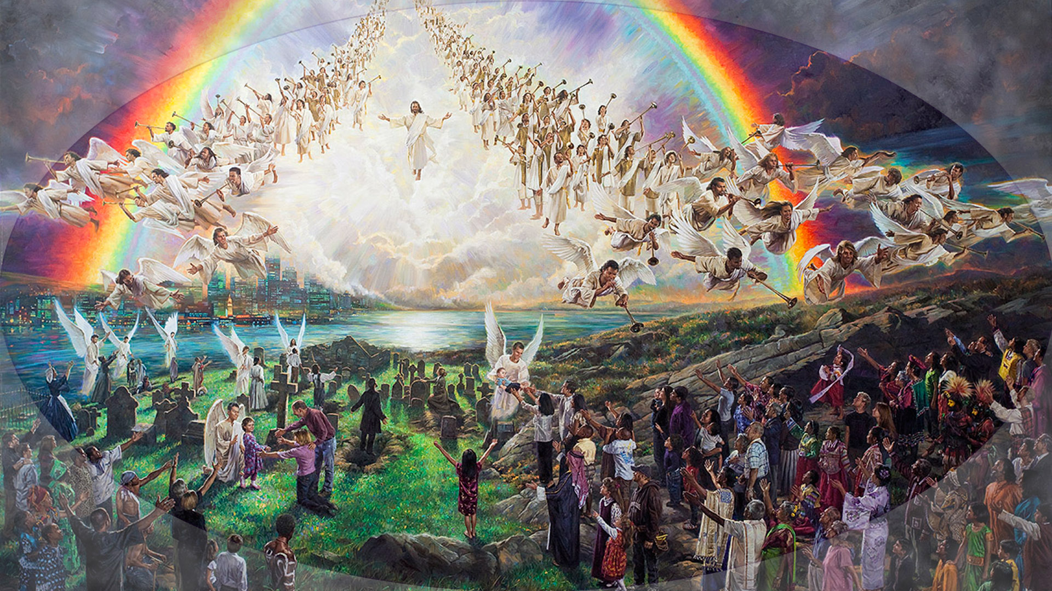
Notes:
¹⁶ For the Lord Himself will descend from heaven with a shout, with the voice of an archangel, and with the trumpet of God. And the dead in Christ will rise first. ¹⁷ Then we who are alive and remain shall be caught up together with them in the clouds to meet the Lord in the air. And thus, we shall always be with the Lord.
[Have pianist start playing #623 quietly]

Slide 50
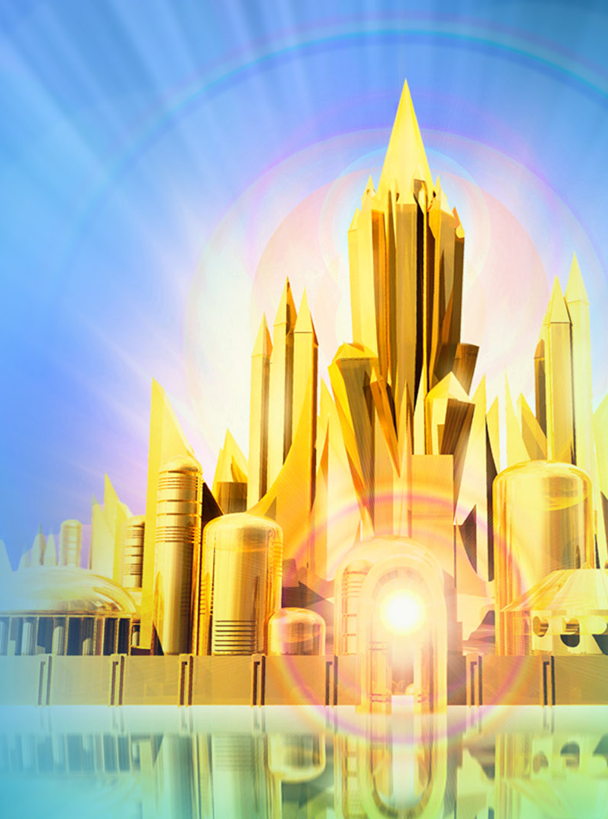
I Will Follow Thee
(Hymn 623)
1
I will follow Thee, my Savior, Wheresoe’er my lot may be. Where thou goest I will follow; Yes, my Lord, I’ll follow Thee.
Refrain
I will follow Thee, my Savior, Thou didst shed Thy blood for me; And though all men should forsake Thee; By Thy grace I’ll follow Thee.
Notes:
[Read below before the song]
I want you to think about the words as we sing so let’s read them before we sing.

Slide 51
I Will Follow Thee
(Hymn 623)
2 Though the road be rough and thorny, Trackless as the foaming sea, Thou hast trod this way before me, And I’ll gladly follow Thee.
3 Though I meet with tribulations, Sorely tempted though I be; I remember Thou wast tempted, And rejoice to follow Thee.

Slide 52
I Will Follow Thee
(Hymn 623)
4 Though Thou leadest me through affliction, Poor, forsaken though I be; Thou wast destitute, afflicted, And I only follow Thee.
5 Though to Jordan’s rolling billows, Cold and deep, Thou leadest me, Thou hast crossed the waves before me, And I still will follow Thee.
Notes:
Let’s stand and sing our closing song, #623.

Slide 53
Notes:
[*** Leave this slide open during the closing song ***]
Now may the God of peace, that brought again from the dead our Lord Jesus, that great shepherd of the sheep, through the blood of the everlasting covenant, make you perfect in every good work to do His will, working in you that which is well pleasing in his sight, through Jesus Christ; to whom be glory for ever and ever. Amen.

Slide 54
Christ Our Righteousness
QR Code to download presentation PDF
Notes:
Point your camera at the icon do download a readable PDF version of the presentation.
Note that the PDF includes both presenter instructions as well presenter text
Also, the presentation PDF may vary slightly from what is presented.

