Slide 1
Sermon title: Abiding 101
Scripture: John 15:1-4
Opening Hymn: Trust and Obey (590)
Closing Hymn: What a Friend We Have in Jesus (499)
Dates Given: 4/20/24 6/8/24
Take Along: - Pavel Goia books (One Miracle … and In the Spirit and Power)
Bulletin Info: Click here. Steps to Christ Chapter 8, 69.1 to end (as much as will fit)
Notes:
Related Information from Steps to Christ chapter 8:
------------------------------------------------------------------------
Many have an idea that they must do some part of the work [their sanctification] alone. They have trusted in Christ for the forgiveness of sin, but now they seek by their own efforts to live aright. But every such effort must fail. Jesus says, “Without Me ye can do nothing.” Our growth in grace, our joy, our usefulness,—all depend upon our union with Christ. It is by communion with Him, daily, hourly,—by abiding in Him,—that we are to grow in grace. He is not only the Author, but the Finisher of our faith. It is Christ first and last and always. He is to be with us, not only at the beginning and the end of our course, but at every step of the way. David says, “I have set the Lord always before me: because He is at my right hand, I shall not be moved.”
Do you ask, “How am I to abide in Christ?” In the same way as you received Him at first. “As ye have therefore received Christ Jesus the Lord, so walk ye in Him.” “The just shall live by faith.” Colossians 2:6; Hebrews 10:38. You gave yourself to God, to be His wholly, to serve and obey Him, and you took Christ as your Savior. You could not yourself atone for your sins or change your heart; but having given yourself to God, you believe that He for Christ's sake did all this for you. By faith you became Christ's, and by faith you are to grow up in Him—by giving and taking. You are to give all,—your heart, your will, your service,—give yourself to Him to obey all His requirements; and you must take all,—Christ, the fullness of all blessing, to abide in your heart, to be your strength, your righteousness, your everlasting helper,—to give you power to obey.
Consecrate yourself to God in the morning; make this your very first work. Let your prayer be, “Take me, O Lord, as wholly Thine. I lay all my plans at Thy feet. Use me today in Thy service. Abide with me, and let all my work be wrought in Thee.” This is a daily matter. Each morning consecrate yourself to God for that day. Surrender all your plans to Him, to be carried out or given up as His providence shall indicate. Thus, day by day you may be giving your life into the hands of God, and thus your life will be molded more and more after the life of Christ.
A life in Christ is a life of restfulness. There may be no ecstasy of feeling, but there should be an abiding, peaceful trust. Your hope is not in yourself; it is in Christ. Your weakness is united to His strength, your ignorance to His wisdom, your frailty to His enduring might. So, you are not to look to yourself, not to let the mind dwell upon self, but look to Christ. Let the mind dwell upon His love, upon the beauty, the perfection, of His character. Christ in His self-denial, Christ in His humiliation, Christ in His purity and holiness, Christ in His matchless love—this is the subject for the soul's contemplation. It is by loving Him, copying Him, depending wholly upon Him, that you are to be transformed into His likeness.
Jesus says, “Abide in Me.” These words convey the idea of rest, stability, confidence. Again, He invites, “Come unto Me, ... and I will give you rest.” Matthew 11:28. The words of the psalmist express the same thought: “Rest in the Lord, and wait patiently for Him.” And Isaiah gives the assurance, “In quietness and in confidence shall be your strength.” Psalm 37:7; Isaiah 30:15. This rest is not found in inactivity; for in the Savior’s invitation the promise of rest is united with the call to labor: “Take My yoke upon you: ... and ye shall find rest.” Matthew 11:29. The heart that rests most fully upon Christ will be most earnest and active in labor for Him.
When the mind dwells upon self, it is turned away from Christ, the source of strength and life. Hence it is Satan's constant effort to keep the attention diverted from the Savior and thus prevent the union and communion of the soul with Christ. The pleasures of the world, life's cares and perplexities and sorrows, the faults of others, or your own faults and imperfections—to any or all of these he will seek to divert the mind. Do not be misled by his devices. Many who are really conscientious, and who desire to live for God, he too often leads to dwell upon their own faults and weaknesses, and thus by separating them from Christ he hopes to gain the victory. We should not make self the center and indulge anxiety and fear as to whether we shall be saved. All this turns the soul away from the Source of our strength. Commit the keeping of your soul to God, and trust in Him. Talk and think of Jesus. Let self be lost in Him. Put away all doubt; dismiss your fears. Say with the apostle Paul, “I live; yet not I, but Christ lives in me: and the life which I now live in the flesh I live by the faith of the Son of God, who loved me, and gave Himself for me.” Galatians 2:20. Rest in God. He is able to keep that which you have committed to Him. If you will leave yourself in His hands, He will bring you off more than conqueror through Him that has loved you.
When Christ took human nature upon Him, He bound humanity to Himself by a tie of love that can never be broken by any power save the choice of man himself. Satan will constantly present allurements to induce us to break this tie—to choose to separate ourselves from Christ. Here is where we need to watch, to strive, to pray, that nothing may entice us to choose another master; for we are always free to do this. But let us keep our eyes fixed upon Christ, and He will preserve us. Looking unto Jesus, we are safe. Nothing can pluck us out of His hand. In constantly beholding Him, we “are changed into the same image from glory to glory, even as by the Spirit of the Lord.”
It was thus that the early disciples gained their likeness to the dear Savior. When those disciples heard the words of Jesus, they felt their need of Him. They sought, they found, they followed Him. They were with Him in the house, at the table, in the closet, in the field. They were with Him as pupils with a teacher, daily receiving from His lips lessons of holy truth. They looked to Him, as servants to their master, to learn their duty. Those disciples were men “subject to like passions as we are.” James 5:17. They had the same battle with sin to fight. They needed the same grace, in order to live a holy life.
Even John, the beloved disciple, the one who most fully reflected the likeness of the Savior, did not naturally possess that loveliness of character. He was not only self-assertive and ambitious for honor, but impetuous, and resentful under injuries. But as the character of the Divine One was manifested to him, he saw his own deficiency and was humbled by the knowledge. The strength and patience, the power and tenderness, the majesty and meekness, that he beheld in the daily life of the Son of God, filled his soul with admiration and love. Day by day his heart was drawn out toward Christ, until he lost sight of self in love for his Master. His resentful, ambitious temper was yielded to the molding power of Christ. The regenerating influence of the Holy Spirit renewed his heart. The power of the love of Christ wrought a transformation of character. This is the sure result of union with Jesus. When Christ abides in the heart, the whole nature is transformed. Christ's Spirit, His love, softens the heart, subdues the soul, and raises the thoughts and desires toward God and heaven.
When Christ ascended to heaven, the sense of His presence was still with His followers. It was a personal presence, full of love and light. Jesus, the Savior, who had walked and talked and prayed with them, who had spoken hope and comfort to their hearts, had, while the message of peace was still upon His lips, been taken up from them into heaven, and the tones of His voice had come back to them, as the cloud of angels received Him—“Lo, I am with you always, even unto the end of the world.” Matthew 28:20. He had ascended to heaven in the form of humanity. They knew that He was before the throne of God, their Friend and Savior still; that His sympathies were unchanged; that He was still identified with suffering humanity. He was presenting before God the merits of His own precious blood, showing His wounded hands and feet, in remembrance of the price He had paid for His redeemed. They knew that He had ascended to heaven to prepare places for them, and that He would come again and take them to Himself.
As they met together after the ascension, they were eager to present their requests to the Father in the name of Jesus. In solemn awe they bowed in prayer, repeating the assurance, “Whatsoever ye shall ask the Father in My name, He will give it you. Hitherto have ye asked nothing in My name: ask, and ye shall receive, that your joy may be full.” John 16:23, 24. They extended the hand of faith higher and higher with the mighty argument, “It is Christ that died, yea rather, that is risen again, who is even at the right hand of God, who also maketh intercession for us.” Romans 8:34. And Pentecost brought them the presence of the Comforter, of whom Christ had said, He “shall be in you.” And He had further said, “It is expedient for you that I go away: for if I go not away, the Comforter will not come unto you; but if I depart, I will send Him unto you.” John 14:17; 16:7. Henceforth through the Spirit, Christ was to abide continually in the hearts of His children. Their union with Him was closer than when He was personally with them. The light, and love, and power of the indwelling Christ shone out through them, so that men, beholding, “marveled; and they took knowledge of them, that they had been with Jesus.”
All that Christ was to the disciples, He desires to be to His children today; for in that last prayer, with the little band of disciples gathered about Him, He said, “Neither pray I for these alone, but for them also which shall believe on Me through their word.” John 17:20. Jesus prayed for us, and He asked that we might be one with Him, even as He is one with the Father. What a union is this! The Savior has said of Himself, “The Son can do nothing of Himself;” “the Father that dwelleth in Me, He doeth the works.” John 5:19; 14:10. Then if Christ is dwelling in our hearts, He will work in us “both to will and to do of His good pleasure.” Philippians 2:13. We shall work as He worked; we shall manifest the same spirit. And thus, loving Him and abiding in Him, we shall “grow up into Him in all things, which is the head, even Christ.” Ephesians 4:15.

Slide 2
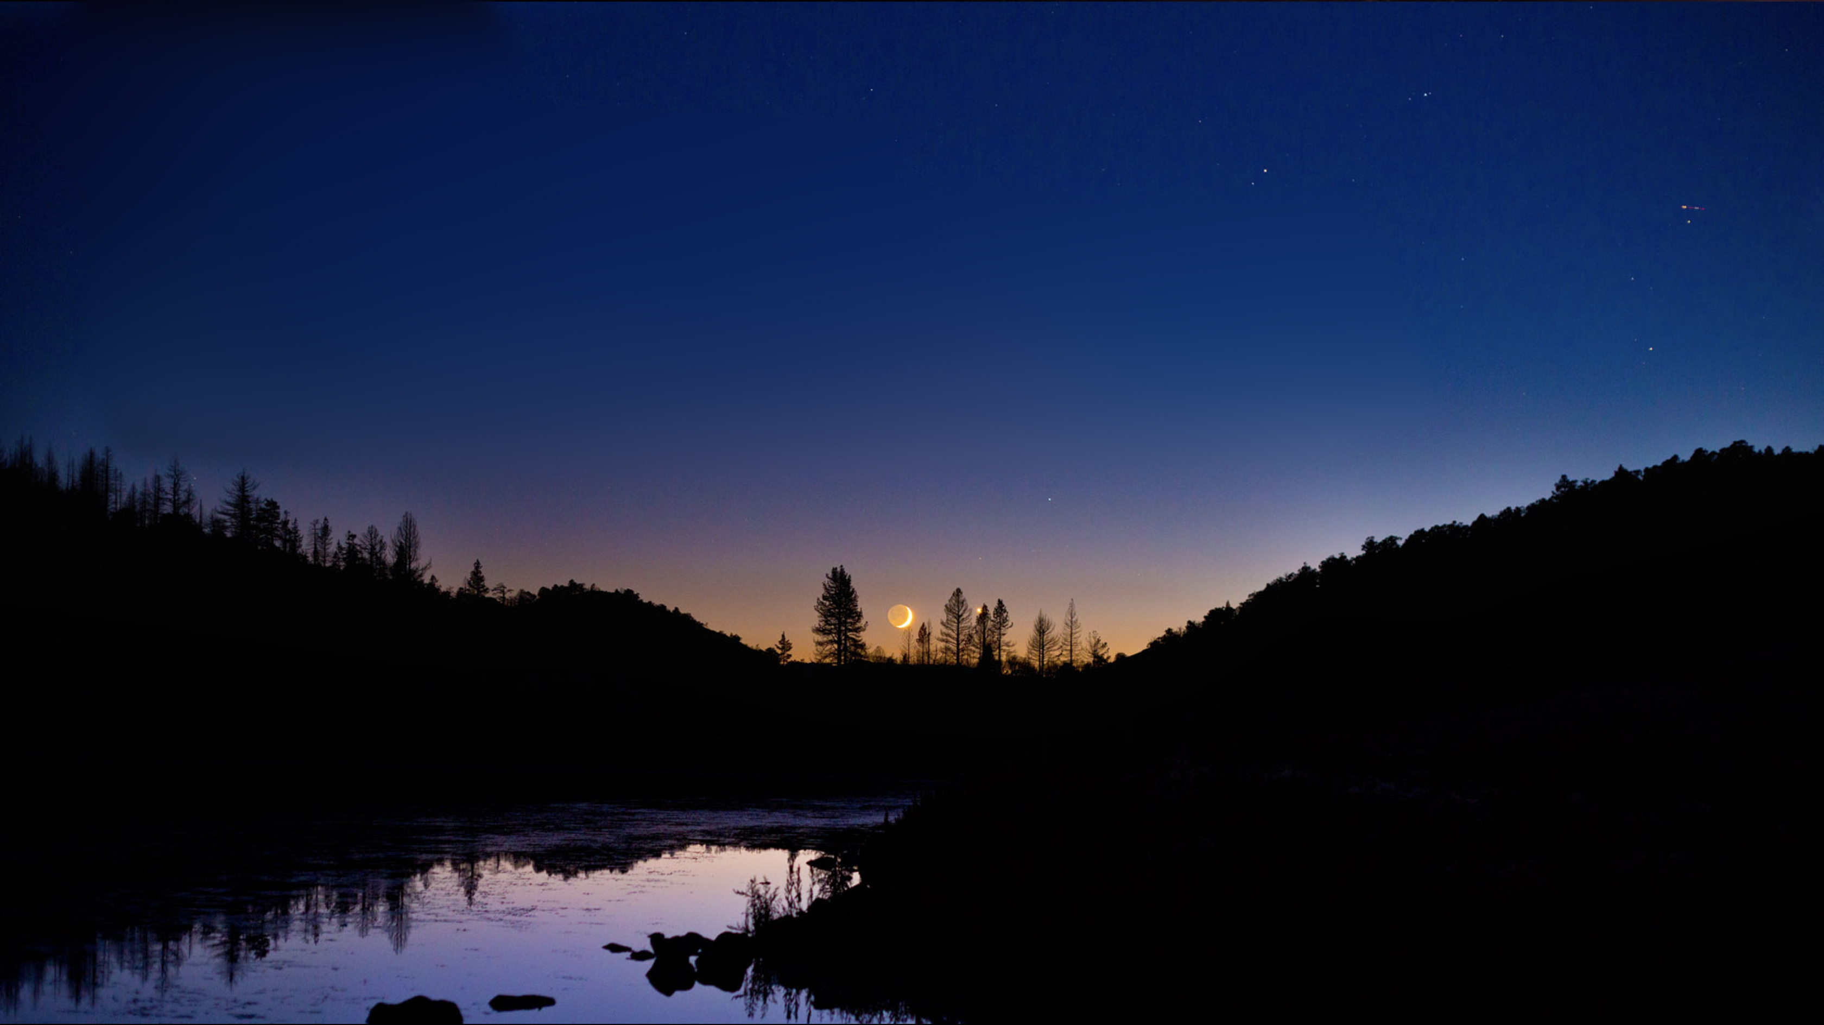
Philippians 4:4
Extra…

Slide 3
Extra…

Slide 4
Extra…

Slide 5
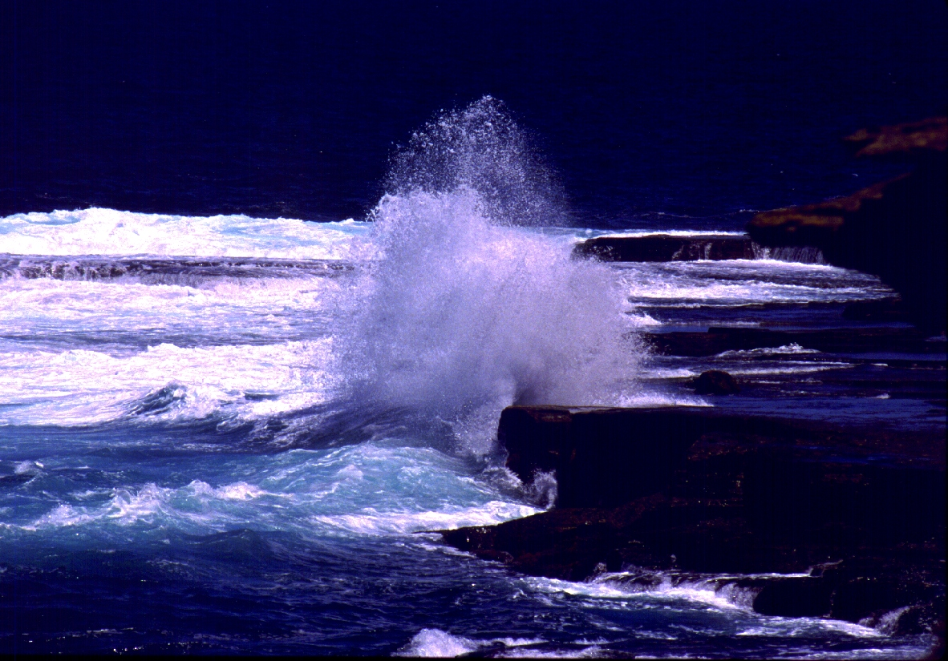
Extra…

Slide 6
Extra…

Slide 7
Abiding 101
Notes:
Smile! Be excited throughout. Smile! Smile! Smile!
Title is Abiding 101 because there is little new content.
Instead, I hope to connect the dots in a new way to help us apply these truths.
These are the lessons that the HS is teaching me on a nearly daily basis.
I have given mental assent to the wisdom in these lessons but am still learning to apply them.
Basic outline is taken from John 15

Slide 8
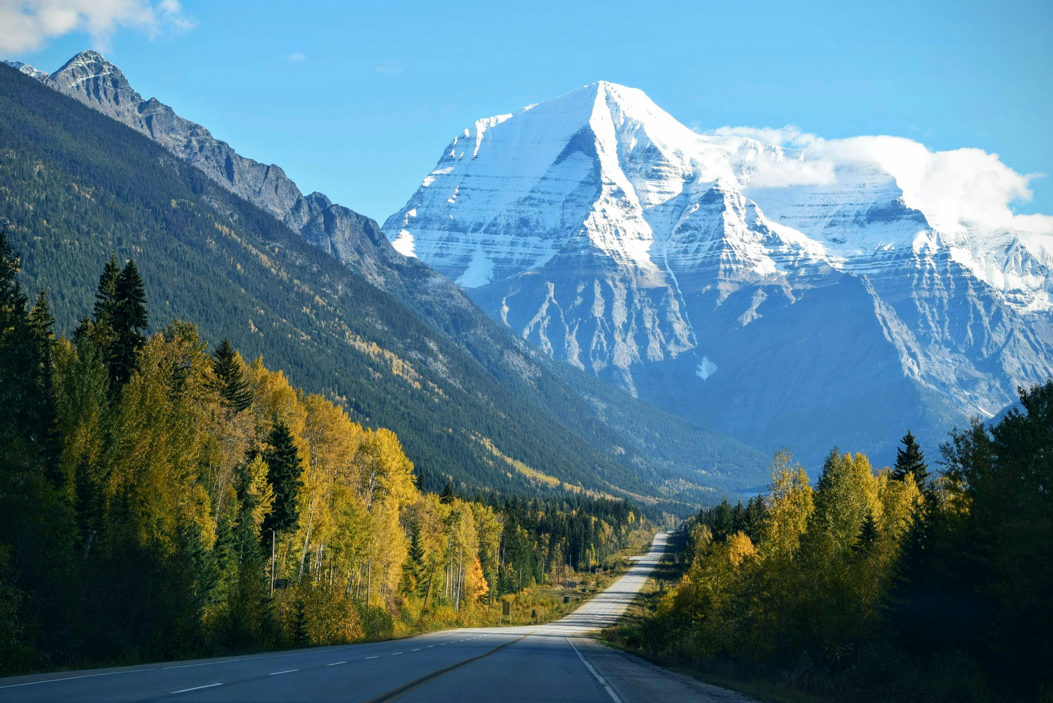
Notes:
My prayer is that this message will bring you a breath of fresh, clean, mountain air in the midst of the struggles of life.
[pray]
Here are a few of the key points from today’s message

Slide 9
Key Point
Abiding is a command; it’s not optional.

Slide 10
Key Point
Abiding brings with it the “peace that surpasses understanding.”

Slide 11
Key Point
Life is tough; it is supposed to be!
Think of our struggles as spring training for heaven!
If life was easy, we might never look up and find God.
Notes:
[Read slide then below]
“And unto Adam he said, Because thou hast hearkened unto the voice of thy wife, and hast eaten of the tree, of which I commanded thee, saying, Thou shalt not eat of it: cursed is the ground for thy sake; in sorrow shalt thou eat of it all the days of thy life.”

Slide 12
Key Point
Life’s struggles are as much a blessing from God as our wonderful material and relational blessings.

Slide 13
Key Point
Trust and obey, For there’s no other way To be happy in Jesus, But to trust and obey!

Slide 14
Summary of Key Points
Thy Will Be Done!
Notes:
Our Attitude: submission to God and His plan for our lives; submission in all ways and at all times

Slide 15
Notes:
First a quick review of some appropriate Bible truths:

Slide 16
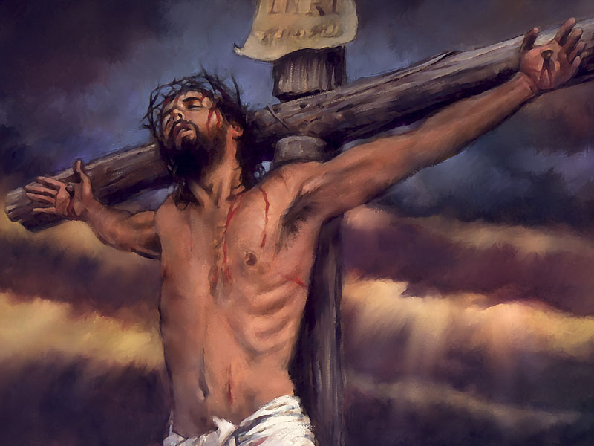
John 3:16
“For God so loved the world that He gave. . .”
Notes:
First, God’s great love

Slide 17
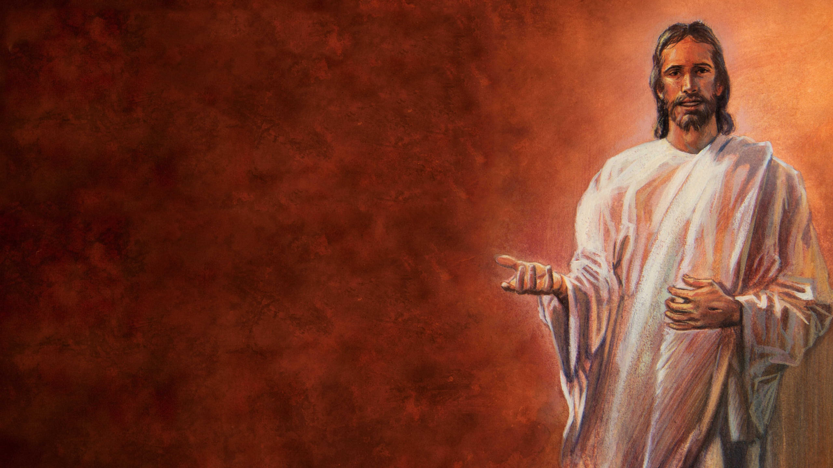
Jeremiah 31:3
“Yes, I have loved you with an everlasting love . . .”

Slide 18
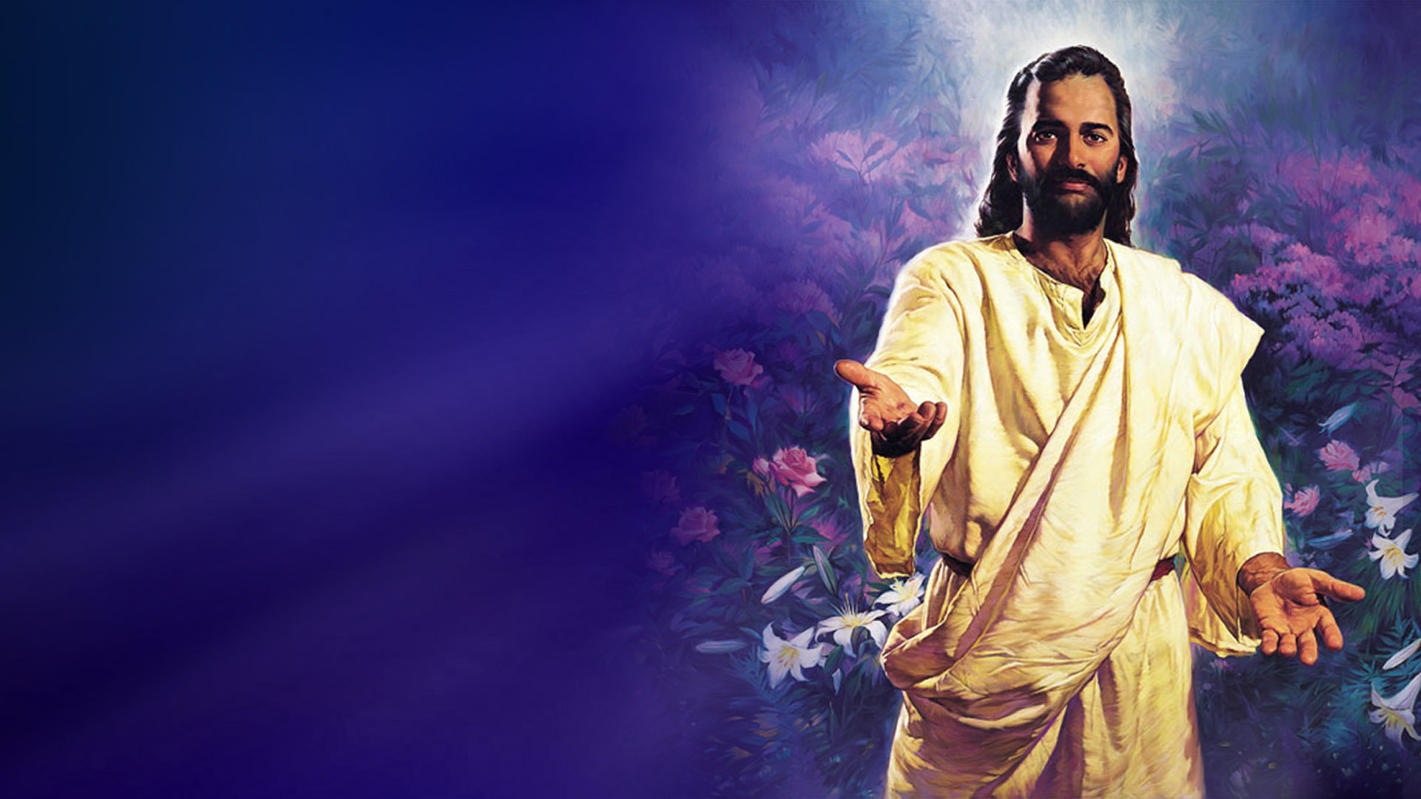
Jeremiah 29:11-13
“¹¹ For I know the thoughts that I think toward you, says the Lord, thoughts of peace and not of evil, to give you a future and a hope.

Slide 19
1 Corinthians 2:9
Eye hath not seen, nor ear heard, neither have entered into the heart of man, the things which God hath prepared for them that love him.

Slide 20
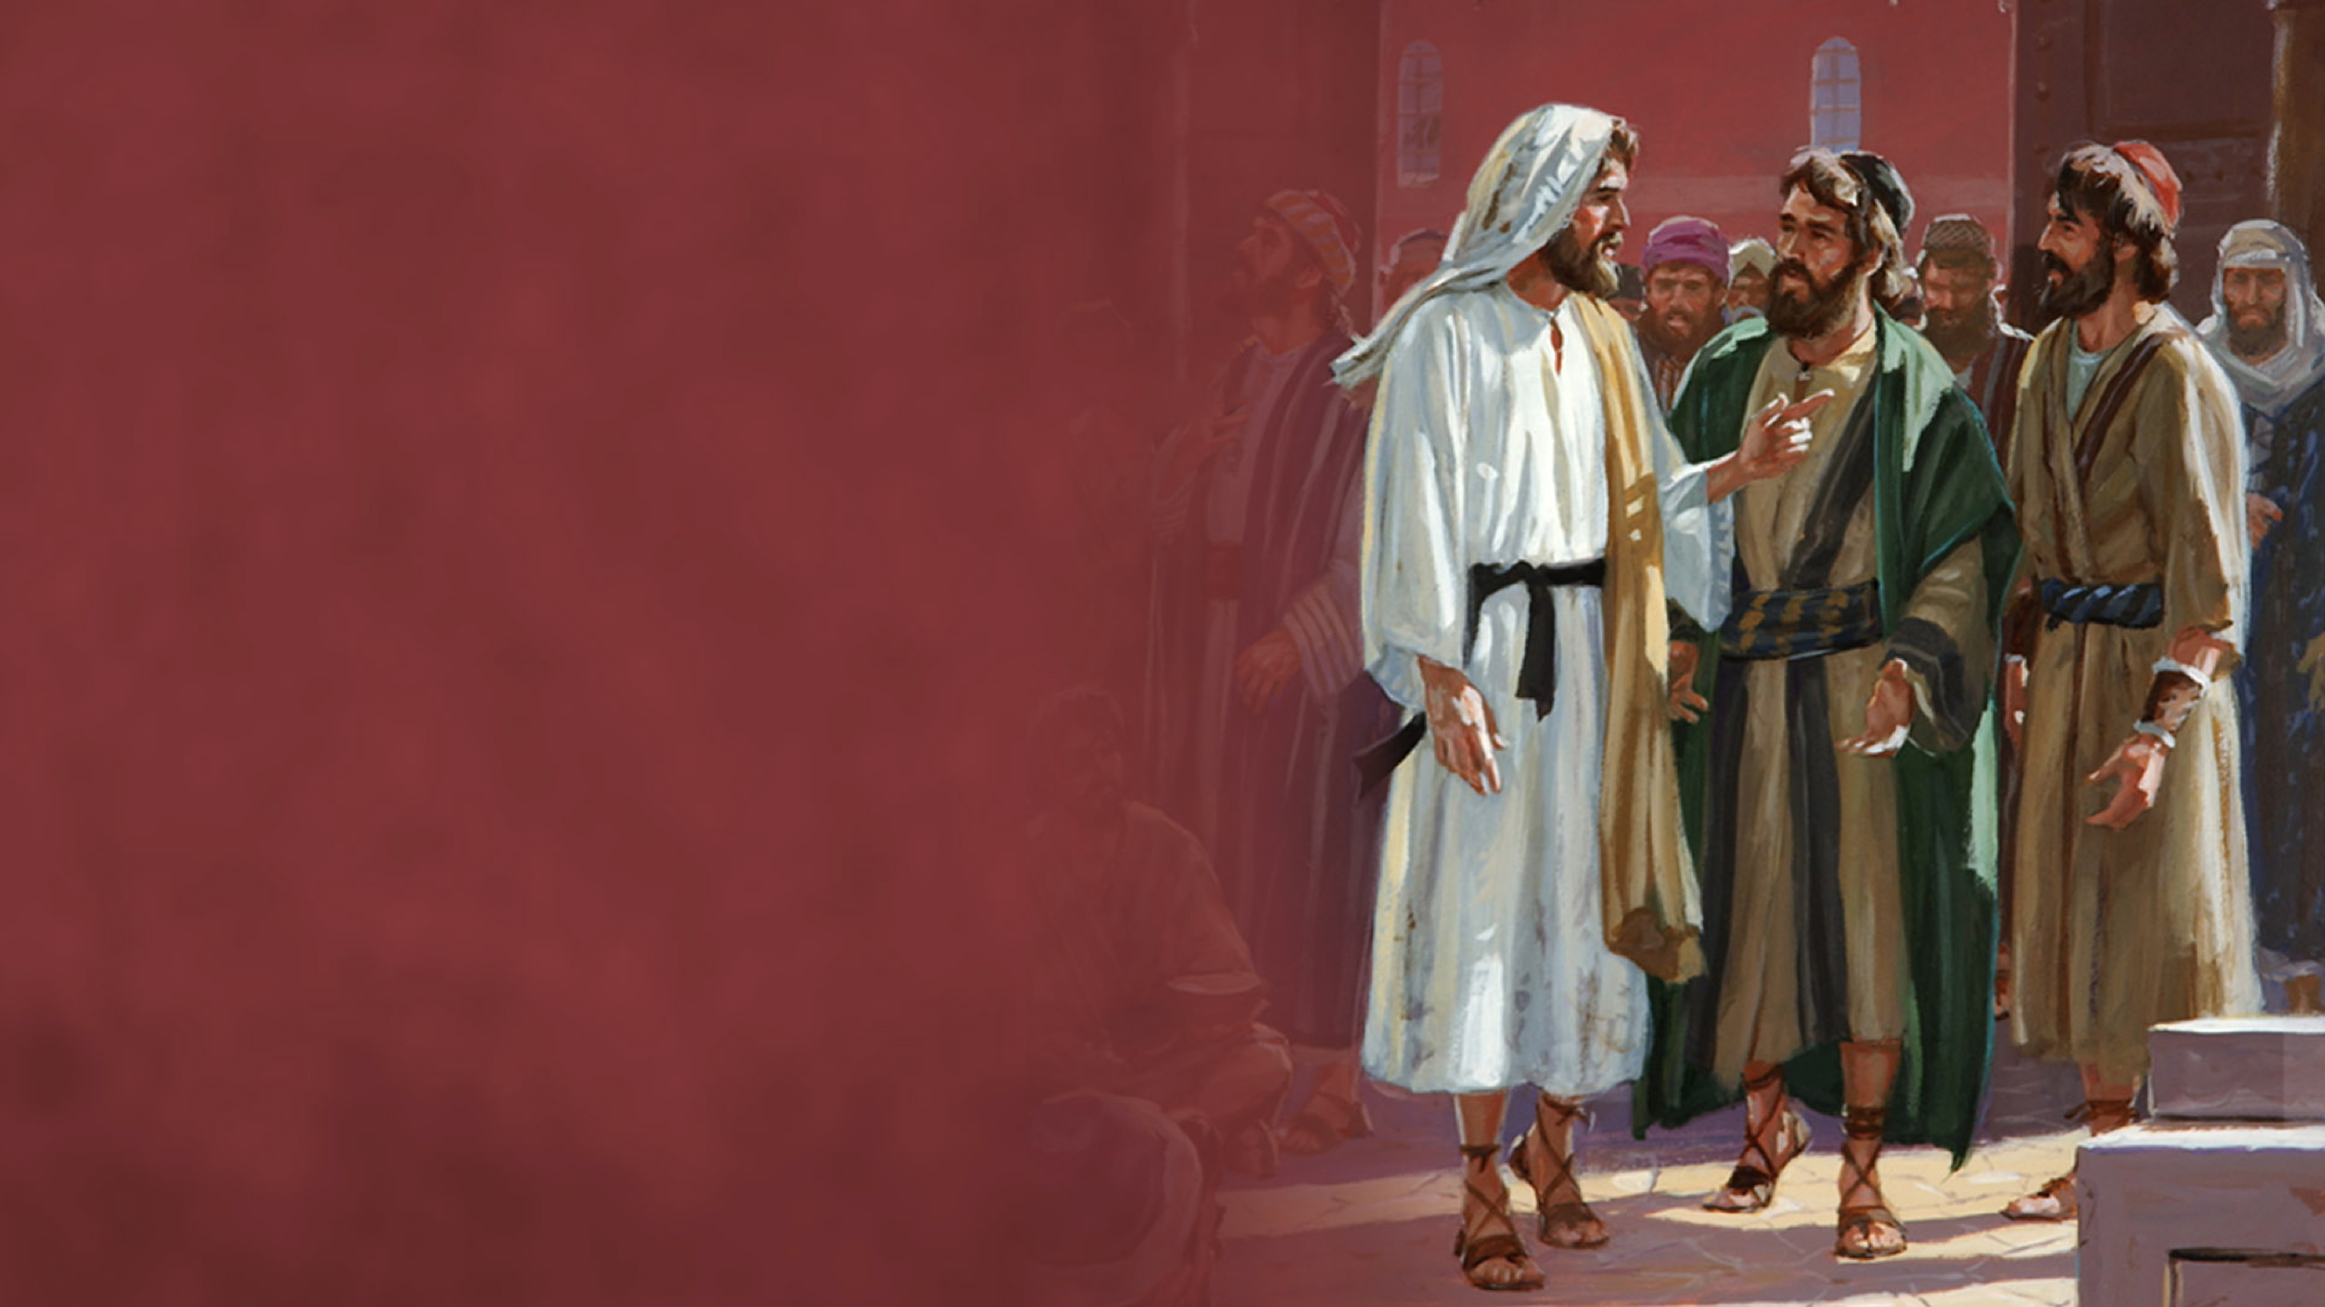
Luke 19:10
“For the Son of man is come to seek and to save that which was lost.”
Notes:
Christ’s mission

Slide 21
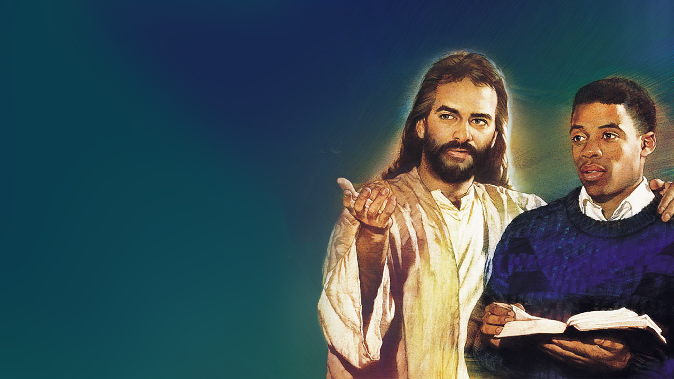
John 17:24
Father, I desire that they also whom You gave Me may be with Me where I am, …
Notes:
Christ wants us to be in heaven with him.

Slide 22
Luke 14:23
“And the lord said unto the servant, Go out into the highways and hedges, and compel them to come in, that my house may be filled.

Slide 23
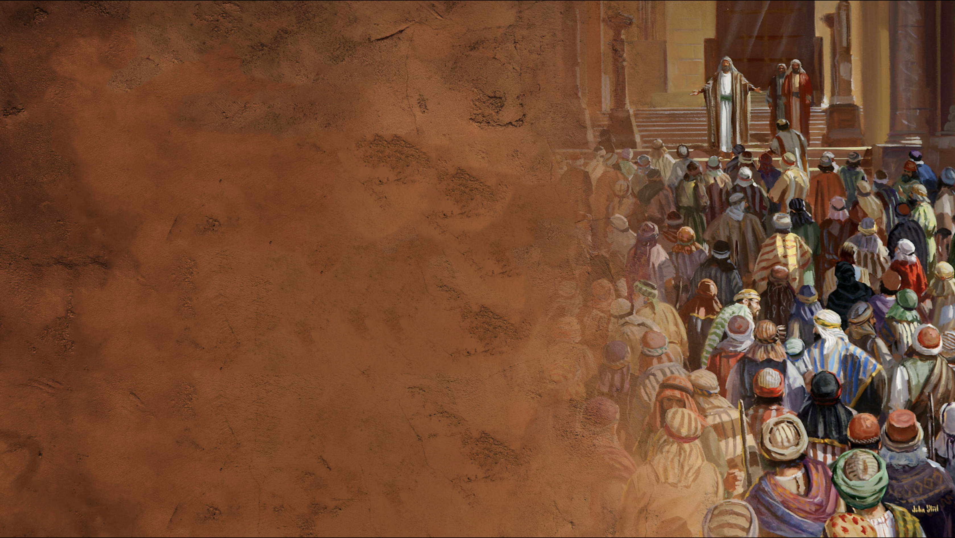
2 Peter 3:9
“The Lord is not slack concerning his promise, as some men count slackness; but is longsuffering to us-ward, not willing that any should perish, but that all should come to repentance.”

Slide 24
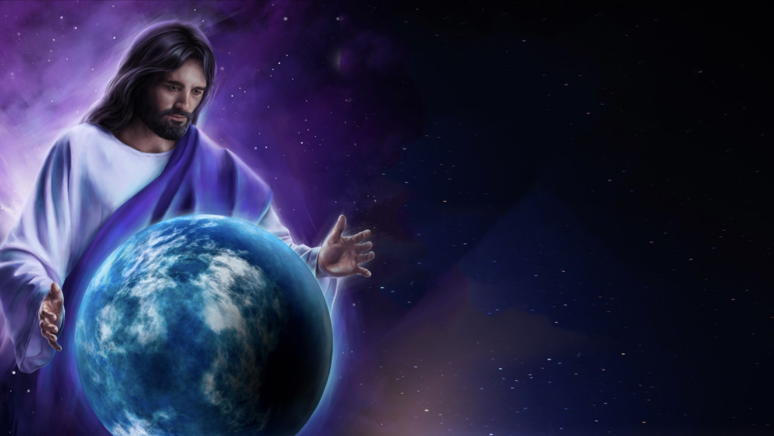
God and Time
Isaiah 65:17 ^{NKJV}
God is omnipresent in space and time.
God exists in all time at the same time.
God doesn’t view the future as if watching television.
God is in your future as much as He is in your now.
Notes:
God knows everything (Omniscience)!
[Next 4 times then]
Is this clear?
Is it not clear that He knows our current struggles as well as all future struggles?
More on this in a moment.

Slide 25
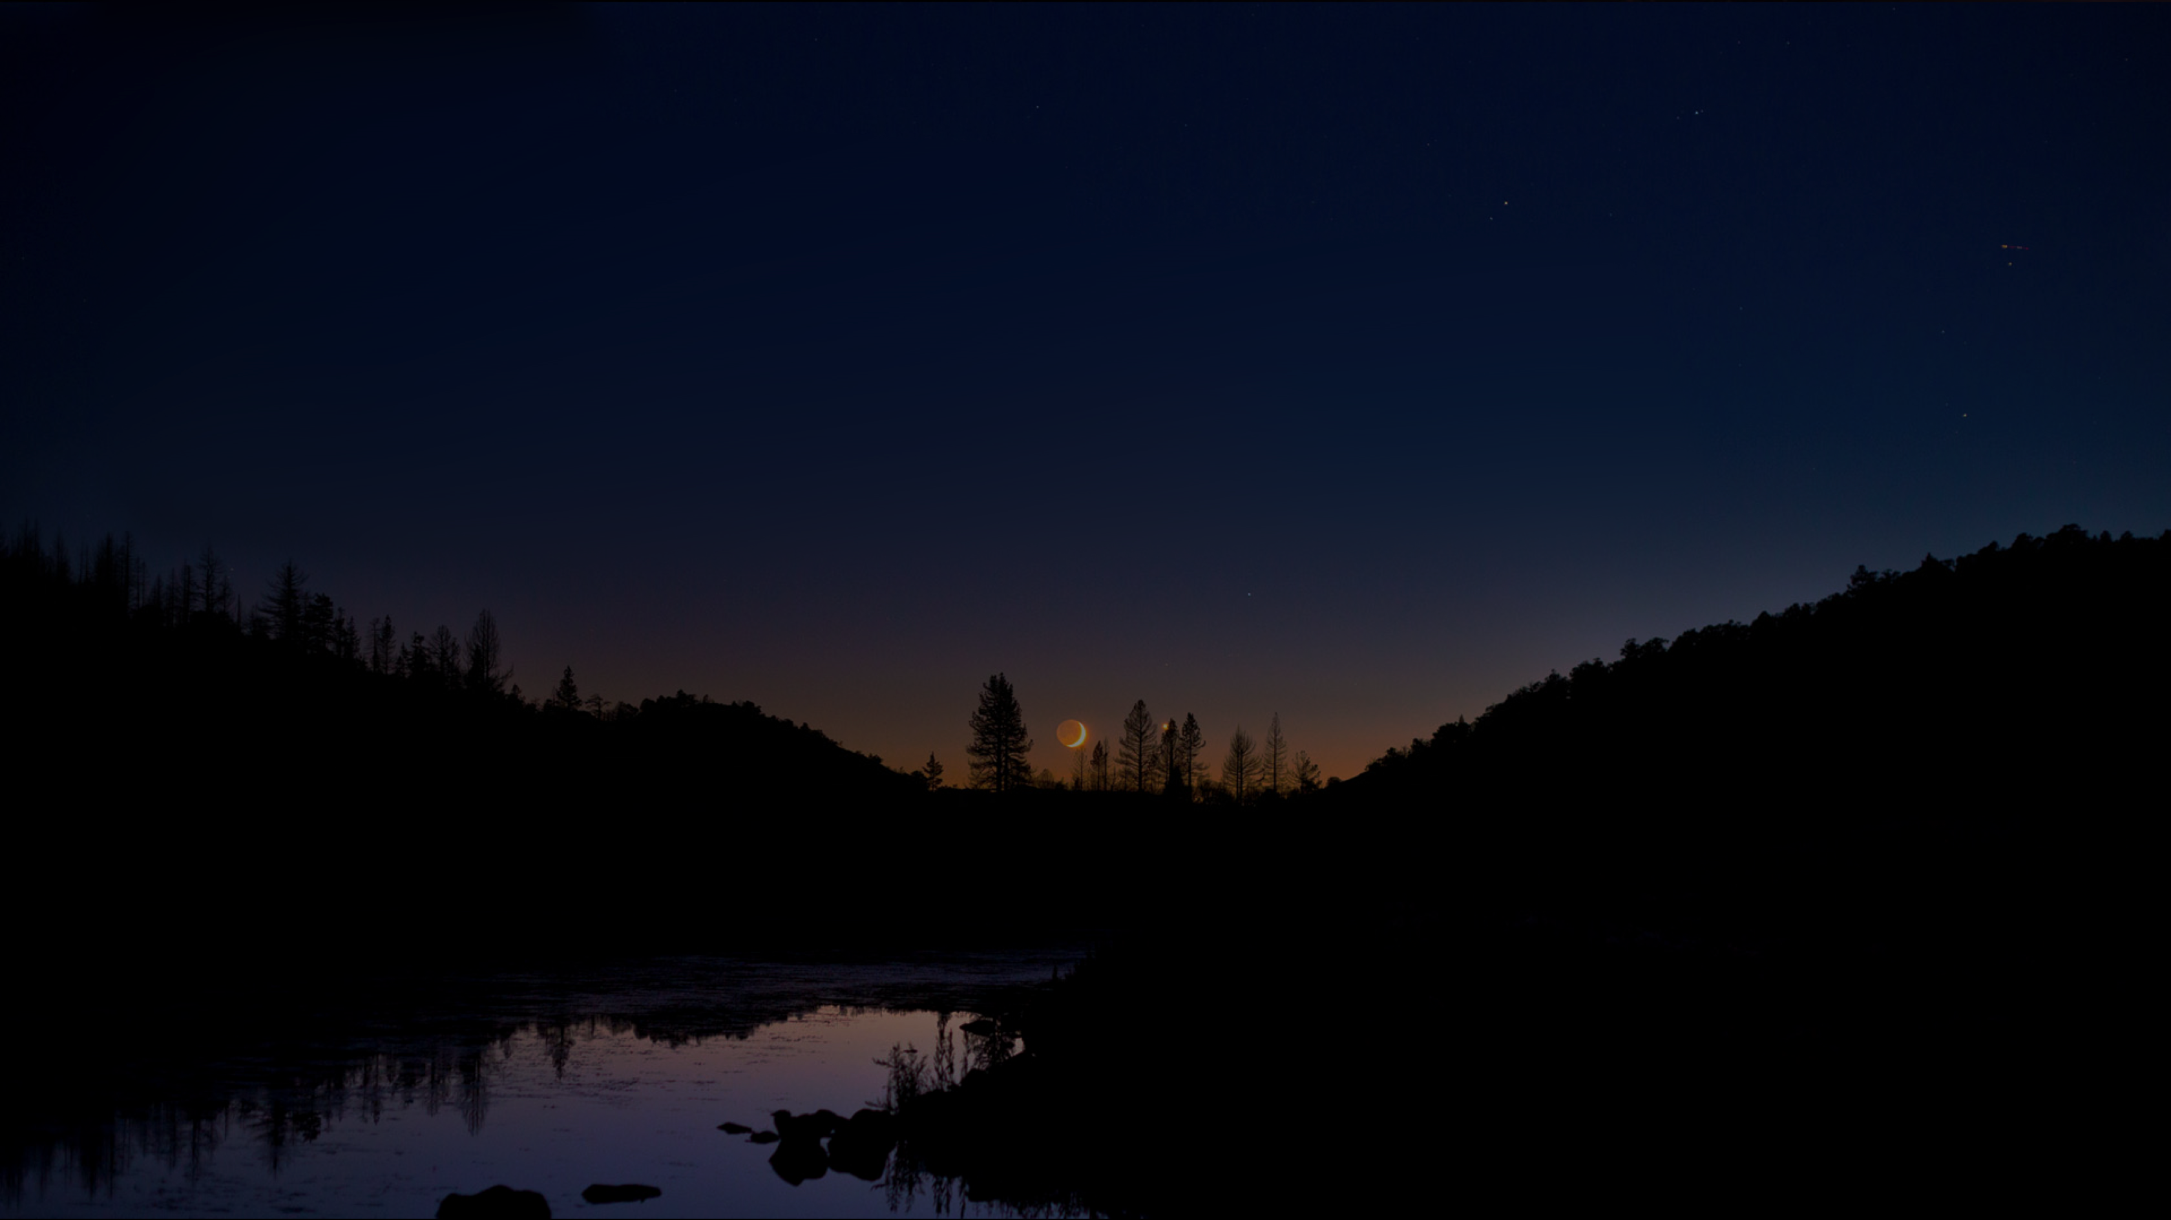
Psalm 139:1-10
God is Always With Us
“O Lord, You have searched me and known me. ² You know my sitting down and my rising up; You understand my thought afar off. ³ You comprehend my path and my lying down, And are acquainted with all my ways. ⁴ For there is not a word on my tongue, But behold, O Lord, You know it altogether. ⁵ You have hedged me behind and before, And laid Your hand upon me. ⁶ Such knowledge is too wonderful for me; It is high, I cannot attain it. ⁷ Where can I go from Your Spirit? Or where can I flee from Your presence? ⁸ If I ascend into heaven, You are there; If I make my bed in hell, behold, You are there. ⁹ If I take the wings of the morning, And dwell in the uttermost parts of the sea, ¹⁰ Even there Your hand shall lead me, And Your right hand shall hold me.
Notes:
[Read Green Highlighted only but commend entire psalm]
Okay, now let’s start digging through the first verses of John chapter 15

Slide 26
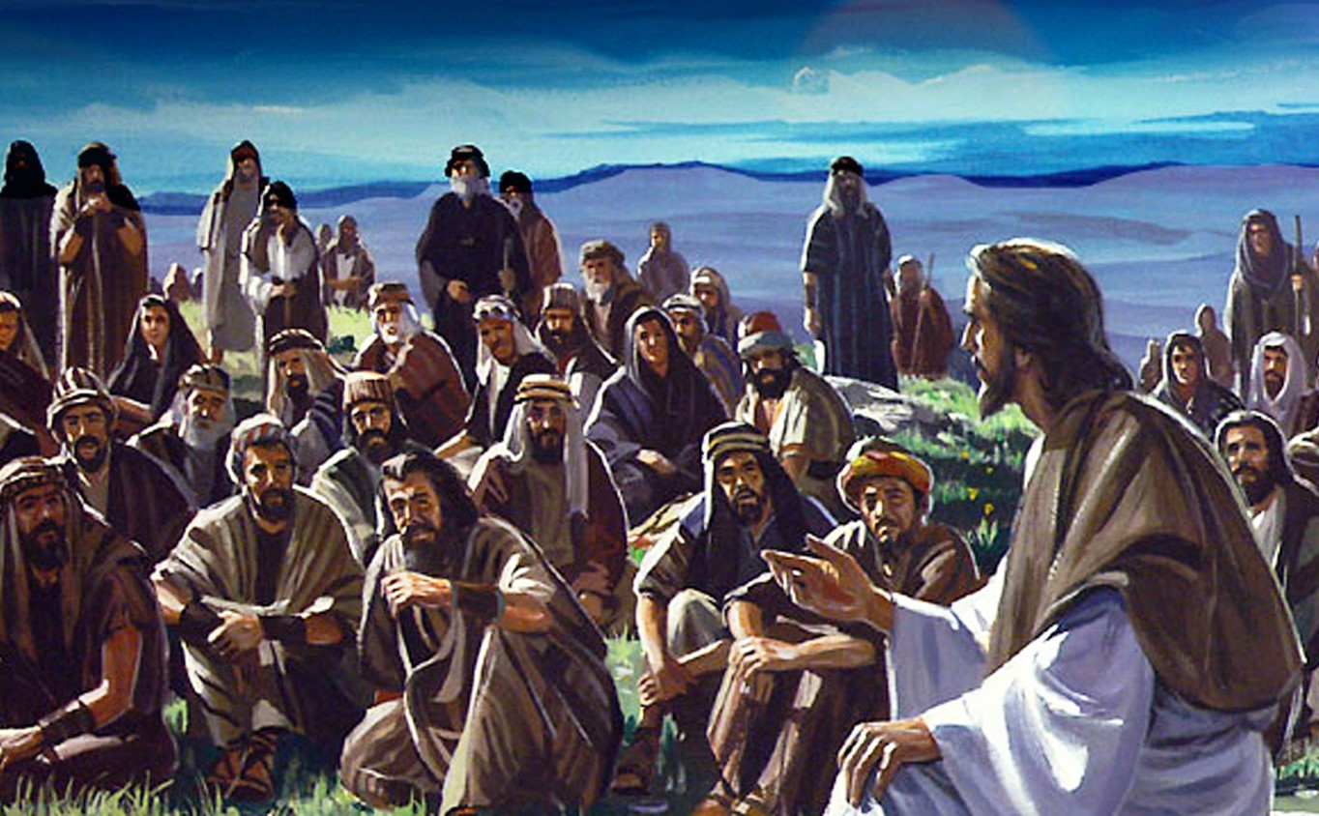
John 15: The vine
“I am the vine, ye are the branches.”
Notes:
Let’s freewheel a bit on the vine analogy:
All wisdom and spiritual nourishment comes from Christ.
Christ also sustains our physical bodies.
Branches have other branches:
They share the nourishment received from the vine and/or other branches: Implication is that we can (must) share the life we have in Jesus with others. Nobody can naysay your personal testimony. Consider where you would be without what the Lord has done for you and then share your hope.
We are held together as a people by being part of the vine (and parts of each other).
We are all parts of the body of Christ, each with his/her own function.
Other thoughts on this analogy of the Vine and the Branches?

Slide 27
John 15:1
“I am the true vine, and my Father is the husbandman.”
Notes:
True Vine implies that there are false vines to which we can attach ourselves.
In the end, Satan and those he controls are the false vines.

Slide 28
John 15:2
“Every branch in me that does not bear fruit he takes away [lifts up]: and every branch that bears fruit, he prunes it, that it may bring forth more fruit.”
Notes:
Takes away: Greek has an alternate sense of lifting or lifting up.
Grapes do not grow on branches that are in the dirt.
A good husbandman tries to save those branches by lifting them (up), cleaning them up, and tying them to keep them out of the dirt.
Prunes
Removes the dead and diseased material and anything that is not conducive to bearing fruit.
Christ, likewise, takes us through the fires of affliction to “prune” us.

Slide 29
John 15:3
“You are already clean because of the word which I have spoken to you.”
Notes:
Clean
Covered by Christ’s righteousness by accepting Him as Lord and Savior.

Slide 30
John 15:4
“Abide in Me, and I in you. As the branch cannot bear fruit of itself, unless it abides in the vine, neither can you, unless you abide in Me.”
Notes:
[Read slide first]
Let’s look at the definition of the word Abide then come back to this verse.

Slide 31
Abide (Webster online)
Transitive verb
1a. To bear patiently; tolerate. “…cannot abide such nonsense”
1b. To endure without yielding; withstand.
“…abide the onrush of the enemy.”
2. To wait for; await. “I will abide the coming of my lord.”
3. To accept without objection. “…Abide a decision.”
Intransitive verb
To remain stable or fixed in a state.
“…a love that abided with him all his days.”
To continue in a place; sojourn.
“…will abide in the house of the Lord forever.”
Notes:
[Read slide first]
Implications:
Implies an extremely close relationship with the Lord
Implies absolute trust at all time regardless of the difficulty of the situation.
Consider Psalm 91 on abiding

Slide 32
Psalms 91:1, 4
“¹He who dwells in the secret place of the Most High shall abide under the shadow of the Almighty… ⁴He shall cover you with his feathers, and under his wings shalt thou trust…
Notes:
If you need encouragement, read Psalm 91:
----------------------
¹ He that dwelleth in the secret place of the most High shall abide under the shadow of the Almighty. ² I will say of the Lord, He is my refuge and my fortress: my God; in him will I trust. ³ Surely he shall deliver thee from the snare of the fowler, and from the noisome pestilence. ⁴ He shall cover thee with his feathers, and under his wings shalt thou trust: his truth shall be thy shield and buckler. ⁵ Thou shalt not be afraid for the terror by night; nor for the arrow that flies by day; ⁶ Nor for the pestilence that walks in darkness; nor for the destruction that wastes at noonday. ⁷ A thousand shall fall at thy side, and ten thousand at thy right hand; but it shall not come nigh thee. ⁸ Only with thine eyes shalt thou behold and see the reward of the wicked. ⁹ Because thou hast made the Lord, which is my refuge, even the most High, thy habitation; ¹⁰ There shall no evil befall thee, neither shall any plague come nigh thy dwelling. ¹¹ For he shall give his angels charge over thee, to keep thee in all thy ways. ¹² They shall bear thee up in their hands, lest thou dash thy foot against a stone. ¹³ Thou shalt tread upon the lion and adder: the young lion and the dragon shalt thou trample under feet. ¹⁴ Because he hath set his love upon me, therefore will I deliver him: I will set him on high, because he hath known my name. ¹⁵ He shall call upon me, and I will answer him: I will be with him in trouble; I will deliver him, and honor him. ¹⁶ With long life will I satisfy him, and shew him my salvation.

Slide 33
John 15:4
“Abide in Me, and I in you. As the branch cannot bear fruit of itself, unless it abides in the vine, neither can you, unless you abide in Me.”
Notes:
Back to verse 4
[Read slide]
Unless the old man dies (daily), we will not be abiding and will bear no fruit.
We must be abiding in Christ so He can lead us to the works that will bear fruit for the kingdom of God.
If self seeks & does the works, there is no fruit for this is salvation by works! (See Gal. 2:20).
Seeking for and doing good works in order to gain points is an abomination to the Lord.

Slide 34
Questions #1
Does God love us with a perfect love?
Since God exists equally in all time, does God know our struggles?
Could God easily prevent each and every new challenge?
Could God easily resolve your current struggles in an instant?
Though He promises wisdom and help through the struggles, He does not prevent or remove them!
WHY? …
Only conclusion is that struggles for our ultimate good, perhaps the good of others, and, for God’s ultimate vindication and Glory!
Bottom line is that God knows that some struggles are needed to prepare us for future struggles and for heaven!
Notes:
[Read below first]
We live in a fallen world so bad things do happen to good people!
But God is still in control:
He created everything with His word
By His will, all things are held together
Given this, let’s ask a few tough questions:
[Next 8 times then ask]
In other words, life is tough because it has to be.
Think of life as spring training for heaven!
Here’s an interesting thought: if life was easy, would we ever seek God?
“Cursed is the ground for your sake!” (Genesis 3:17)
[Pause]
Questions so far?
Let’s begin with a quick exposé of the reasons for struggles and then ways to handle them

Slide 35
Some Reasons Life’s Trials
A Consequence of our sin or our mistakes.
To chip away things in our lives that do not conform to His image.
To prepare us for future work in His vineyard; to give us the ability to cope with future crises that God knows that we are to face.
So that we can comfort others with the comfort we have received during similar experiences.
Because there this is a fallen world and bad things happen to God’s children.
Notes:
Some: more details could be added to this list but the main thing is to recognize that God is always working for our good regardless of the reasons for life’s struggles.
[Next 5 times noting:]
Consequences: For boundaries, there must be consequences in our lives. As parents, we give adverse consequences to our children to mold their character. You can easily that the generation rioting on college campuses have never had proper boundaries!
Chip away: Michealangelo example with sculpture in stone.
Prepare us: Examples from life of David: a) Using a sling; & b) and 10 years learning to trust in God as Saul sought his life
Comfort: Gloria lost her first husband and was thus able to comfort others in a similar situation in ways that those that have not experienced that grief cannot understand.
Fallen World: Note that God even chooses to allow these struggles and will use then for our good and His glory to accomplish any of the above results.

Slide 36
Be Proactive
“Everything can be taken from a man but one thing: the last of the human freedoms – to choose one's attitude in any given set of circumstances, to choose one's own way.” Viktor Frankl
Steven Covey in Seven Habits of Highly Effective People says choosing our response is habit one, our being “proactive.”
Covey indicates that we are “response-able”, that is, we can choose our response to issues and trials.
The thought is to pry open a space between arrival of a stimulus and our response to it. Then we can interject conscious thought. For the Christian, this thought is a prayer.
Notes:
[Notes for each]
Frankl being in Auschwitz.
Describe book briefly
The concept is to open space between stimulus and response to add conscious thought. For the Christian, that means a quick prayer. Jesus always had the exactly correct response to every situation and He will give us wisdom in similar situations, but only if we ask.
Here’s a quick example:

Slide 37
“Wherefore the king said unto me,
‘why is thy countenance sad, seeing thou art not sick? This is nothing else but sorrow of heart.’ ³ Then I was very sore afraid, and said unto the king, ‘Let the king live for ever: why should not my countenance be sad, when the city, the place of my fathers’ sepulchers, lieth waste, and the gates thereof are consumed with fire?’ ⁴ Then the king said unto me, ‘for what dost thou make request? So I prayed to the God of heaven. …’”
Nehemiah 2:2-4
Notes:
[Read below first then highlighted on slide]
Nehemiah had just learned of the extreme distress of his people in Jerusalem.
Nehemiah was able to consider his response long enough to fire off a quick prayer to God.
(Note: Nehemiah didn’t ask the king for time to run to his prayer closet…)

Slide 38
Questions #2
So, how does being proactive help us keep a proper attitude?
Expect trials and thank God for them before we start each day. This includes existing struggles and new ones to be encountered.
Thank God for new trials as they are encountered knowing that they are for our good.
We need not get angry, frustrated.
We mustn’t complain! It says God
doesn’t know what he is doing.
We keep a proper attitude by
abiding in Christ.
Notes:
[Show one at a time with minimum comments]
[Next 5 times]
Let’s expand this injunction against complaints:

Slide 39
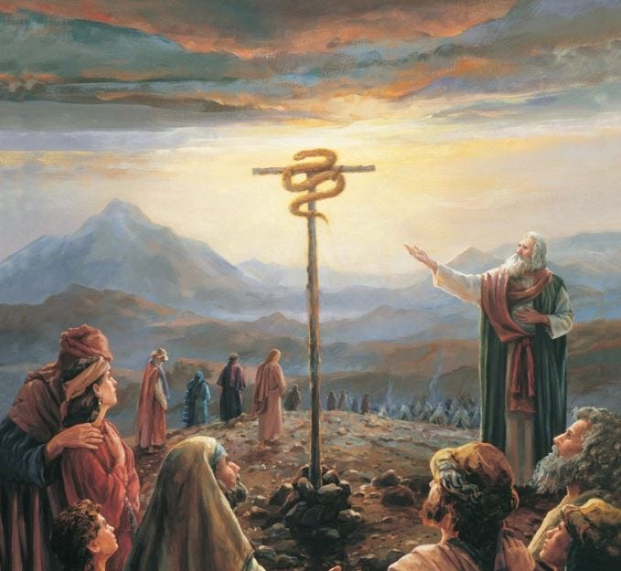
Numbers 21:5-6
⁵ “And the people spoke against God and against Moses: ‘Why have you brought us up out of Egypt to die in the wilderness?’ ⁶ So the Lord sent fiery serpents among the people…”
Notes:
[Read scripture first then…]
God is not real fond of complaining!
Our brains are associative. Like attracts like in the brain.
Negative speech is highly contagious: One person can infect a thousand!
Say something negative and Satanic agents will bring a flood of other negative thoughts to the mind of each hearer!
Say something negative and one or more in a crowd will say something more negative.
This can spread until there’s nothing but negative being shared.
Know anyone that is always upbeat and positive? What’s it like to be around them?
[Pause for replies]
Why not be someone like that? Try 24 hours with no negative statements. Ask family members to hold you accountable.

Slide 40
Abiding and Trust
Abiding requires absolute trust in Christ!
Conversely, having this absolute trust means that we will be abiding.
Properly understood, then, abiding eliminates worry and will bring the promised peace.
Notes:
Shifting gears here, consider:
[Read slide]

Slide 41
Psalms 91:4 ^{NKJV}
“He shall cover you with His feathers, and under His wings you shall take refuge; His truth shall be your shield and buckler.”
Notes:
The peace of God that passes understanding…

Slide 42
Trust and Obey (590)
When we walk with the Lord In the light of His Word, What a glory He sheds on our way; While we do His good will, He abides with us still, And with all who will trust and obey.
→
Notes:
[Click → for other verses]

Slide 43
H
Trust and Obey (590)
Not a shadow can rise, Not a cloud in the skies, But His smile quickly drives it away; Not a doubt or a fear, Not a sigh or a tear, Can abide while we trust and obey.

Slide 44
H
Trust and Obey (590)
Not a burden we bear, Not a sorrow we share, But our toil He doth richly repay; Not a grief or a loss, Not a frown or a cross, But is blest if we trust and obey.

Slide 45
H
Trust and Obey (590)
But we never can prove The delights of His love, Until all on the altar we lay; For the favor He shows, And the joy He bestows, Are for them who will
trust and obey!.

Slide 46
Trust and Obey (590)
Trust and obey, For there’s no other way To be happy in Jesus, But to trust and obey.
Notes:
No other way to be happy in Jesus

Slide 47
Philippians 4:4-7
⁴ Rejoice in the Lord always; again I will say, rejoice. … ⁶ do not be anxious about anything, but in everything by prayer and supplication with thanksgiving let your requests be made known to God.
⁷ And the peace of God, which
surpasses all understanding,
will guard your hearts and
your minds in Christ Jesus.
Notes:
[Read quickly]

Slide 48
Philippians 4:4
Absolute Trust
+ Complete Obedience
= Full Surrender
= Abiding
= Peace of God
(no worries)
→
Notes:
[→ for EGW Quote on our obedience seeming like doing our own will]
[Read slide first then below]
We have but one thing we can give to the Lord: Our Wills!
Full surrender keeps Jesus at the center of our lives
We have peace of God because
We don’t have to figure out a way around our problems.
Instead, we wait on the Lord to show us His way through our problems.
Full surrender changes the way you pray.
The focus of your prayers shifts from self to God that His will to be done,
We remember that God has chosen to allow each and every trial/temptation that comes into our lives.
Therefore, instead of asking for a way around the trials or their removal, we ask God to give us wisdom to follow his path through the trials with a humble heart that is willing to learn.
Here’s what Christ says about worry:

Slide 49
H
Obedience (DA 668.3)
All true obedience comes from the heart. It was heart work with Christ. And if we consent, He will so identify Himself with our thoughts and aims, so blend our hearts and minds into conformity to His will, that when obeying Him we shall be but carrying out our own impulses. The will, refined and sanctified, will find its highest delight in doing His service. When we know God as it is our privilege to know Him, our life will be a life of continual obedience. Through an appreciation of the character of Christ, through communion with God, sin will become hateful to us.

Slide 50
No Worry
²⁵ Therefore I say unto you, Take no thought for your life, what ye shall eat, or what ye shall drink; nor yet for your body, what ye shall put on. Is not the life more than meat, and the body than raiment? . . .
³⁴ Take therefore no thought for the morrow: for the morrow shall take thought for the things of itself. Sufficient unto the day is the evil thereof. (Matthew 6)
Notes:
In other words, worry is forbidden (“verboten”, “proibido”)

Slide 51
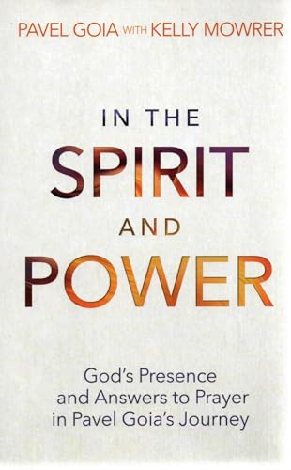
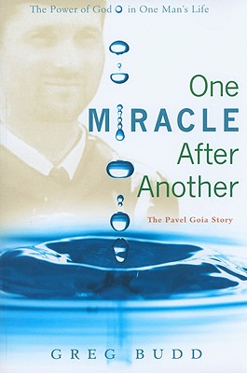
Notes:
[Commend primarily the Spirit Book but also the Miracle book]
The following quote is taken from the Spirit and Power book.
Here is the background to the following quote:
Attending a very tough engineering school.
Only top 10 of the 976 applicants were accepted.
Pavel scored 4th highest!
Bright kid with tremendous potential.
W/O college degree, wages were very low.
Attend Saturday classes or be kicked out for good.

Slide 52
Abiding Will Change Your Prayers¹
I will be expelled and lose everything. Tell me what more I need to do so that He will answer my prayer." Dad paused. "Son," he finally answered, "you need to find a different god."
My mind went blank. "What do you mean?"
"You think God is there to grant your wishes, but He is the master, and you are His servant. You must focus on Him instead of focusing on school."
I still didn't understand. "How do you want me to pray?" I asked.
"You want God to save your schooling and your future. But you are not the center of the universe—Jesus is. …
¹ In Spirit and Power, Pavel Goia, Safeliz 2023. Page 19
Notes:
[Read this slide and then next]

Slide 53
Abiding Will Change Your Prayers¹
When you pray, say, 'Lord, I would like You to save my education; nevertheless, please do what honors You. If my presence in school serves You, let me be there and be a light for You. If not, take me from there and put me wherever honors and serves You. When you give up self and put God in the center, when you fully surrender everything, when you are willing to sacrifice everything, including school, that is the prayer that He answers. "Switch your prayer, son. Then you will experience power. Whatever you try to save, you will lose. But whatever you are willing to lose, surrender, and give to Him, that's what you save. That is what He can protect, preserve, use, and bless.
Notes:
[Read slide first]
Let me express the implications in this way:

Slide 54
Abiding Will Change Your Prayers¹
“…not my will but
Thy Will Be Done”
Notes:
[Next once]

Slide 55
Questions #3
Again, does God know our problems?
If I focus on my problems, who is at the center of my life?
This is pride! (Sometimes called “Hidden pride.)”
This is worry! Worry greatly increases our stress level!
Stress takes years off our lives & lowers mental function.
Note the difference when Jesus is at the center of our lives:
Worry and stress disappear, replaced with peace!
There is power in our prayers!
God can work; sometimes in amazing and unexpected ways!
Notes:
[Next 6 times]

Slide 56
Trust and Love
Trusting Jesus implies love!
To love someone requires that we really know that person.
How can we nourish this love for Christ?
Meditate on how the Lord has bless us in the past.
Count our blessings.
Be in His word
Studying and meditating scenes of the Cross.
Praying back His promises in the Bible
Whatever works for you…
Notes:
[Read slide then next 6 times]
Let’s pick up a few additional details on nourishing our relationship with Jesus

Slide 57
Nourishing Our Love For Christ
Remember All He Has Done
“We have nothing to fear for the future, except as we shall forget the way the Lord has led us, and His teaching in our past history.” (CCh 359.4)
Notes:
[Read slide first]
Meditate on how the Lord has blessed, corrected you, and led you. This will inspire both love and trust.

Slide 58
Nourishing Our Love For Christ
Count Your Blessings
When upon life's billows you are tempest tossed, When you are discouraged, thinking all is lost, Count your many blessings, name them one by one, And it will surprise you what the Lord hath done.
Count your blessings, name them one by one; Count your blessings, see what God hath done; Count your blessings, name them one by one; Count your many blessings, see what God hath done.

Slide 59
Nourishing Our Love For Christ
Daily Bible Reading
KJV Bible PDF Download
Open Bible PDF
Notes:
[Steps to show]
Set laptop for Extend (Windows/P)
Move PDF viewer and other needed apps to projector screen
Start presentation in presenter mode
Describe studying PDF Bible:
Keeping notes
Highlighting
Meditating and thinking

Slide 60
Hebrews 12:5-11
Handling the Struggles
“My son, do not despise the discipline of the Lord, Nor be discouraged when you are rebuked by Him; ⁶ for whom the Lord loves He chastens, and scourges every son whom He receives.” ⁷ If you endure chastening, God deals with you as with sons; for what son is there whom a father does not chasten? ⁸ But if you are without discipline, of which all have become partakers, then you are illegitimate and not sons. ⁹ Furthermore, we have had human fathers who corrected us, and we paid them respect. Shall we not much more readily be in subjection to the Father of spirits and live? ¹⁰ For they indeed for a few days disciplined us as seemed best to them, but He for our profit, that we may be partakers of His holiness. ¹¹ Now no discipline seems to be joyful for the present, but painful; nevertheless, afterwards it yields the peaceable fruit of righteousness to those who have been trained by it.”
Notes:
[1. Note that Chastening = Discipline or Correction]
[2. Read highlighted quickly and commend it to their later review]
[3. Briefly read notes below]
God’s Discipline and correction:
Means God has not given up on us and we are still being treated as sons
Should that not make us want to rejoice?
“Rejoice always; again I say rejoice.” “In all things give thanks for this is the will of God for you.”
“Shall we not much more readily being subjection = Shall we not abide? As in:
Patiently?
Without objection?
Unyielding?
Righteousness = His righteousness as required for heaven

Slide 61
1 Thessalonians 5:18
“In everything give thanks; for this is the will of God in Christ Jesus for you!”
“Trials, when perceived as educators, will produce joy.” (Francois du Plessis)

Slide 62
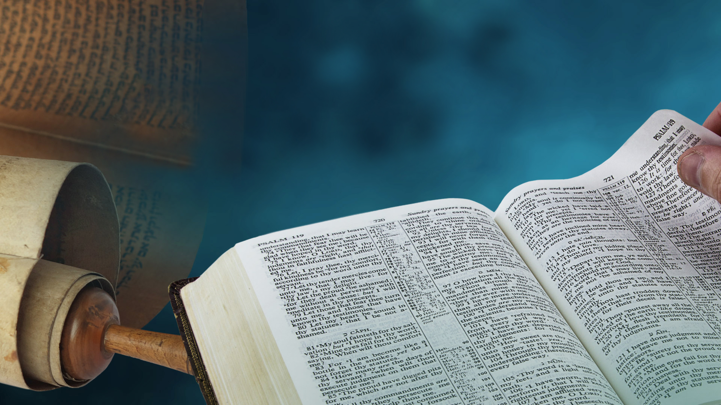
James 1:2-4
“My brethren, count it all joy when you fall into various trials, ³ knowing that the testing of your faith produces patience. ⁴ But let patience have
its perfect work, that you may be perfect and
complete, lacking nothing.”
Notes:
Perfect = Christ’s righteousness.

Slide 63
Hebrews 10:12-13
“There has no testing overtaken you but such as is common to man: but God is faithful, who will not suffer you to be tested above that you are able; but will with the testing also make a way to escape, that you may be able to bear it.”
Notes:
The Greek word translated here as testing means temptation equally.

Slide 64
John 15:4
“Abide in Me, and I in you. As the branch cannot bear fruit of itself, unless it abides in the vine, neither can you, unless you abide in Me.”
Notes:
[This slide is a repeat for review]
All the preceding slides really clarify what it is to abide.

Slide 65
Abide (Webster online)
Transitive verb
1a. To bear patiently; tolerate. “…cannot abide such statements…”
1b. To endure without yielding; withstand. “…abide the onrush of
the enemy.”
2. To wait for; await. “I will abide the coming of my lord.”
3. To accept without objection. “…will abide your decision.”
Intransitive verb
1. To remain stable or fixed in a state. “…a love that abided with
him all his days.”
2. To continue in a place; sojourn. “…will abide in the house of the
Lord forever.”
Notes:
[Repeated for Clarity]
Questions or observations so far?

Slide 66
John 15:5
“… He who abides in Me, and I in him, bears much fruit; for without Me you can do nothing!”
Notes:
We covered the first part of this verse and most have memorized the second part.
What part of nothing do we sometimes not understand? Why do we try to do things on our own to only suffer the consequences?
Consider this passage from Chapter 8 Steps to Christ.

Slide 67
Steps to Christ p 69-70
“Many have an idea that they must do some part of the work alone. They have trusted in Christ for the forgiveness of sin, but now they seek by their own efforts to live aright. But every such effort must fail. Jesus says, “Without Me ye can do nothing.” Our growth in grace, our joy, our usefulness,—all depend upon our union with Christ. It is by communion with Him, daily, hourly,—by abiding in Him,—that we are to grow in grace. He is not only the Author, but the Finisher of our faith. It is Christ first and last and always. He is to be with us, not only at the beginning and the end of our course, but at every step of the way. David says, “I have set the Lord always before me: because He is at my right hand, I shall not be moved.” (SC 69.1)
→
E
Notes:
[E to skip to review and the end]
[Read highlighted only]
[→ For rest of quote]

Slide 68
H
Steps to Christ p 69-71
Do you ask, “How am I to abide in Christ?” In the same way as you received Him at first. “As ye have therefore received Christ Jesus the Lord, so walk ye in Him.” “The just shall live by faith.” Colossians 2:6; Hebrews 10:38. You gave yourself to God, to be His wholly, to serve and obey Him, and you took Christ as your Savior. You could not yourself atone for your sins or change your heart; but having given yourself to God, you believe that He for Christ's sake did all this for you. By faith you became Christ's, and by faith you are to grow up in Him—by giving and taking. You are to give all,—your heart, your will, your service,—give yourself to Him to obey all His requirements; and you must take all,—Christ, the fullness of all blessing, to abide in your heart, to be your strength, your righteousness, your everlasting helper,—to give you power to obey. (SC 69.2)
Notes:
[Read highlighted only if limited time]

Slide 69
H
Steps to Christ p 69-71
Consecrate yourself to God in the morning; make this your very first work. Let your prayer be, “Take me, O Lord, as wholly Thine. I lay all my plans at Thy feet. Use me today in Thy service. Abide with me, and let all my work be wrought in Thee.” This is a daily matter. Each morning consecrate yourself to God for that day. Surrender all your plans to Him, to be carried out or given up as His providence shall indicate. Thus day by day you may be giving your life into the hands of God, and thus your life will be molded more and more after the life of Christ. (SC 70.1)
Notes:
[Read this slide completely]

Slide 70
John 15:6
“If anyone does not abide in Me, he is cast out as a branch and is withered; and they gather them and throw them into the fire, and they are burned.”
Notes:
Sobering warning. Reinforce your walk with Christ every morning w/o fail.

Slide 71
John 15:7-8
“⁷ If you abide in Me, and My words abide in you, you will ask what you desire, and it shall be done for you.
⁸ By this My Father is glorified, that you bear much fruit; so you will be My disciples.”
Notes:
Verse 7
This is not “Name it, claim it” of the prosperity gospel!
When we abide, we will ask as prompted by the Holy Spirit.
We will ask for others to be blessed and the focus will not be on ourselves!!!
Verse 8
Abiding means that we bring glory to God and are Christ’s disciples

Slide 72
John 15:9-10
“⁹ “As the Father loved Me, I also have loved you; abide in My love.
¹⁰ If you keep My commandments, you will abide in My love, just as I have kept My Father’s commandments and abide in His love.”
Notes:
Love is the characteristic of God’s kingdom. This is the agape love – love for one another.
“By this shall all men know that you are my disciples, if you have love for one another.”
“If you love me, keep my commandments.”
Agape changes our prayers from self to others and for them to receive a blessing.
This was a large part of what happened in the upper room.

Slide 73
John 15:11-13
¹¹ “These things I have spoken to you, that My joy may remain in you, and that your joy may be full.
¹² This is My commandment, that you love one another as I have loved you.
¹³ Greater love has no one than this, than to lay down one’s life for his friends.”
Notes:
Again, love is the characteristic of God’s kingdom.
There is no greater joy than being used by God for the blessing of others.

Slide 74
John 15:14-15
“¹⁴ You are My friends if you do whatever I command you. ¹⁵ No longer do I call you servants, for a servant does not know what his master is doing; but I have called you friends, for all things that I heard from My Father I have made known to you.”
Notes:
Moses was listed as a friend of God
Incredibly, Christ considers us as friends when we abide.

Slide 75
John 15:16-17
“¹⁶ You did not choose Me, but I chose you and appointed you that you should go and bear fruit, and that your fruit should remain, that whatever you ask the Father in My name He may give you. ¹⁷ These things I command you, that you love one another.”
Notes:
Chose:
We are chosen to work in His vineyard once we abide in Him.
Fruit:
Souls reached with the Three Angel’s Message and souls that are saved.
Whatever you ask:
Requests that are according to His will, requests for the blessing for others.
Not a bright red, new Lamborghini in the driveway. Not “Name it, Claim it.”

Slide 76
Review
Is God in control?
Does God love you immensely, completely?
Is God worthy of our complete trust?
Does He know what is best for us in all situations?
Aren’t each of our struggles hand-picked by God for our good and His glory?
Aren’t we to thank God in all situations?
Where is worry then?
Notes:
Questions or discussion?
Okay, class; time for the review. Note, the exam starts after the final amen and you leave the church.
☺
[Next 7 times]

Slide 77
Matthew 11:28-30
“²⁸ Come to Me, all you who labor and are heavy laden, and I will give you rest. ²⁹ Take My yoke upon you and learn from Me, for I am gentle and lowly in heart, and you will find rest for your souls. ³⁰ For My yoke is easy and My burden is light.”
Notes:
Abiding in Christ is accepting his light and easy yoke.

Slide 78
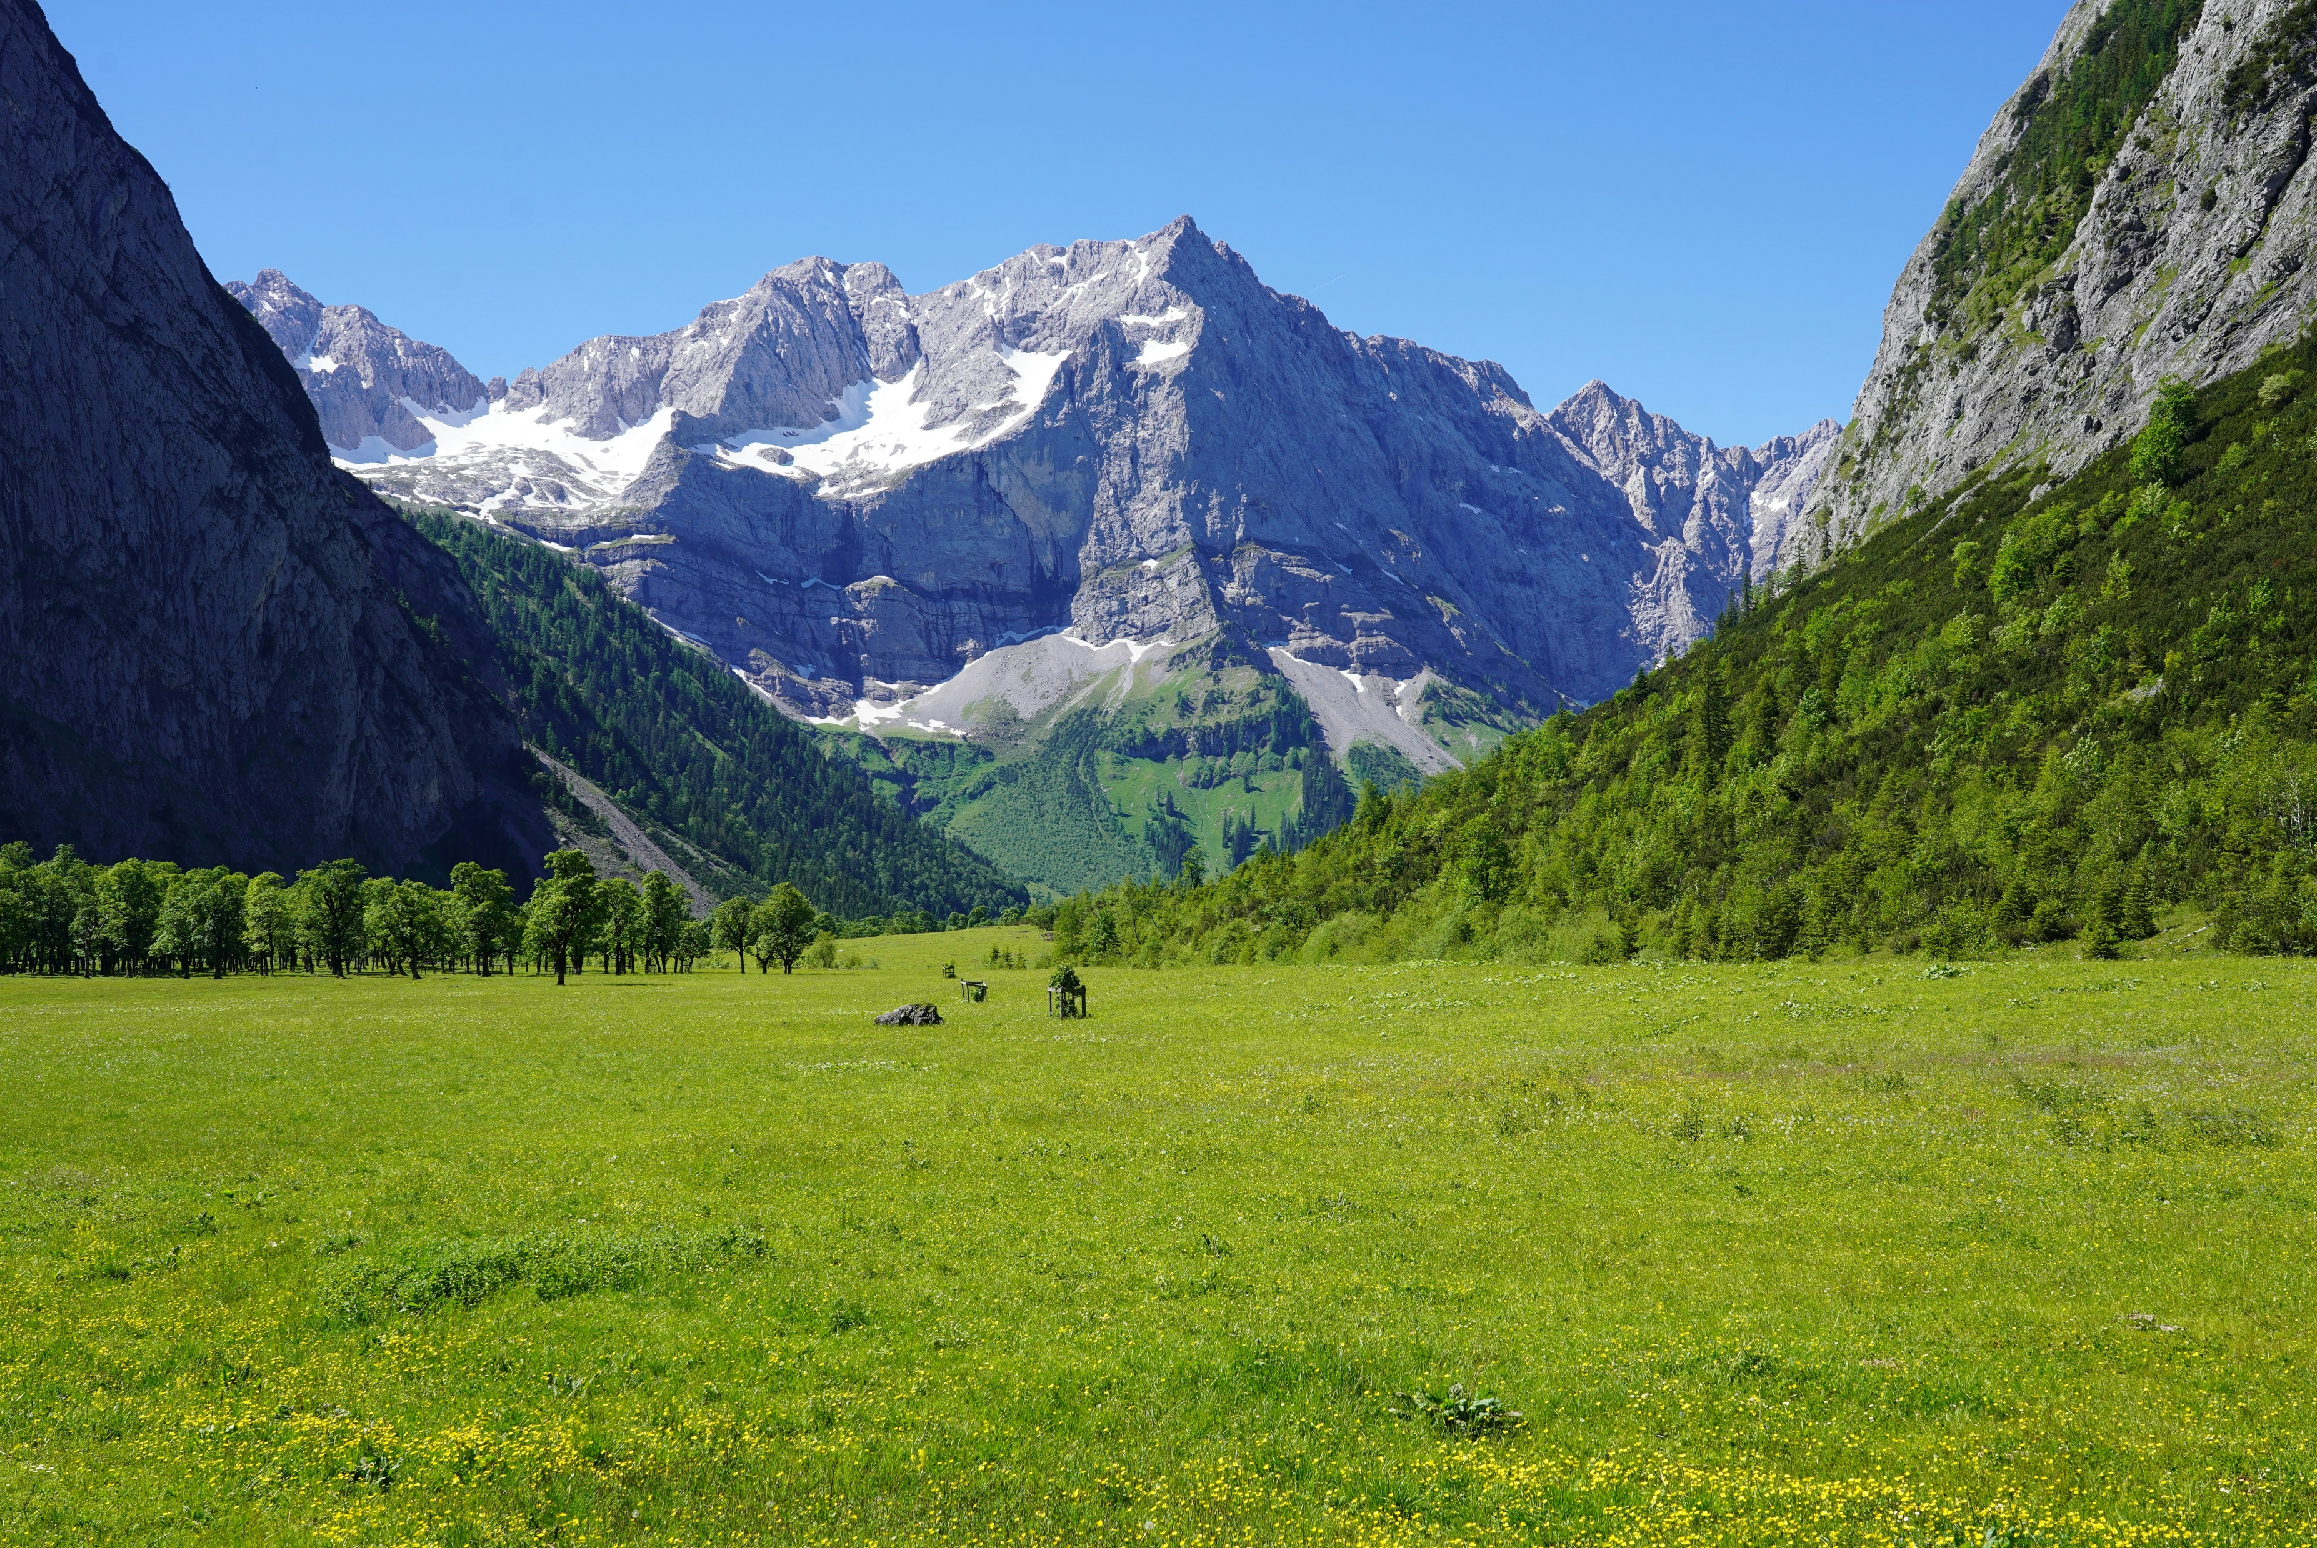
Notes:
[Pause]
Ready for some fresh air in your life?
[Paint visual of giving Lord all our cares]
Pray

Slide 79
Hymn 530: It is Well
1
When peace, like a river, attendeth my way, when sorrows like sea billows roll; whatever my lot, thou hast taught me to say, It is well, it is well with my soul.
2
My sin–oh, the joy of this glorious thought– My sin, not in part but the whole, is nailed to the cross, and I bear it no more, praise the Lord, praise the Lord, O my soul!
3
And Lord, haste the day when my faith shall be
sight, the clouds be rolled back as a scroll; the trump shall resound, and the Lord shall
descend, even so, it is well with my soul..
Refrain
It is well with my soul, it is well, it is well with my soul.

Slide 80
Hymn 499: What a Friend We Have in Jesus
1
What a friend we have in Jesus, All our sins and griefs to bear! What a privilege to carry, Everything to God in prayer! Oh, what peace we often forfeit; Oh, what needless pain we bear All because we do not carry Everything to God in prayer.
2
Have we trials and temptations? Is there trouble anywhere? We should never be discouraged, Take it to the Lord in prayer. Can we find a friend so faithful Who will all our sorrows share? Jesus knows our every weakness Take it to the Lord in prayer.
3
Are we weak and heavy laden, Cumbered with a load of care? Precious Savior, still our refuge; Take it to the Lord in prayer. Do your friends despise, forsake you? Take it to the Lord in prayer. In his arms he’ll take and shield you; You will find a solace there.

Slide 81
Hymn 322: Nothing Between
1
Nothing between my soul and my Savior, naught of this world’s delusive dream; I have renounced all sinful pleasure; Jesus is mine, there’s nothing between.
2
Nothing between, like worldly pleasure; habits of life, though harmless they seem, must not my heart from him ever sever; he is my all, there’s nothing between.
3
Nothing between, e’en many hard trials, though the whole world against me convene; watching with prayer and much self denial, I’ll triumph at last, there’s nothing between.
Refrain
Nothing between my soul and my Savior, so that his blessed face may be seen; nothing preventing the least of his favor; keep the way clear! let nothing between.

Slide 82
Abiding – What Should We Do?
Start your day in prayer thanking God for the trials of that day. Expect daily trials (which God choses for you).
Daily ask for the Holy Sprit.
Immediately give all new difficulties/trials to God with thanks.
As you walk through the day, be at peace in Him in total trust.
Lord, show me my sins. Have I placed anything ahead of you?
Learn from you sins. Learn to recognize Satan’s promptings.
Stay permanently attached to the Vine. He will never leave us.
Draw nourishment only from the Vine not the world!
Daily read and meditate on His word. To trust Christ, you must get to know Him as your best friend.
Claim His promises in prayer.

